Slide 1

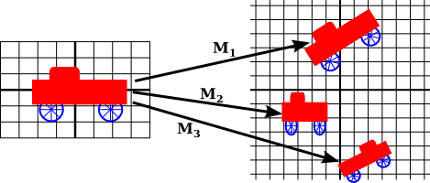
Computer Graphics
Unit-3 part 1
2D transformation and viewing pipeline

Slide 2
Outline
Transformation
Basic transformation
Matrix representation and homogeneous coordinates
Composite transformation
Other transformation
The viewing pipeline
Viewing coordinate reference frame
Window-to-viewport coordinate transformation
Point clipping
Line clipping
Polygon clipping

Slide 3
Transformation
Changing Position, shape, size, or orientation of an object is known as transformation.

Slide 4
Basic Transformation
includes three transformations
Translation,
Rotation
Scaling.
These are known as basic transformation because with combination of them we can obtain any transformation.

Slide 5
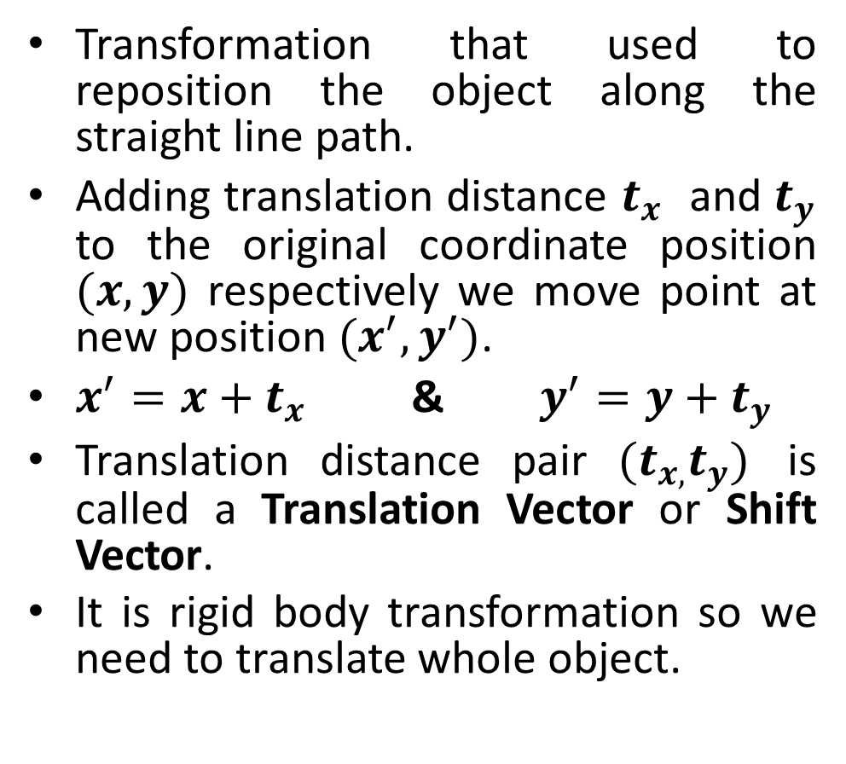
Translation
(x',y')
ty
(x,y)
t_{x}
(x',y')
ty
(x,y)
t_{x}

Slide 6
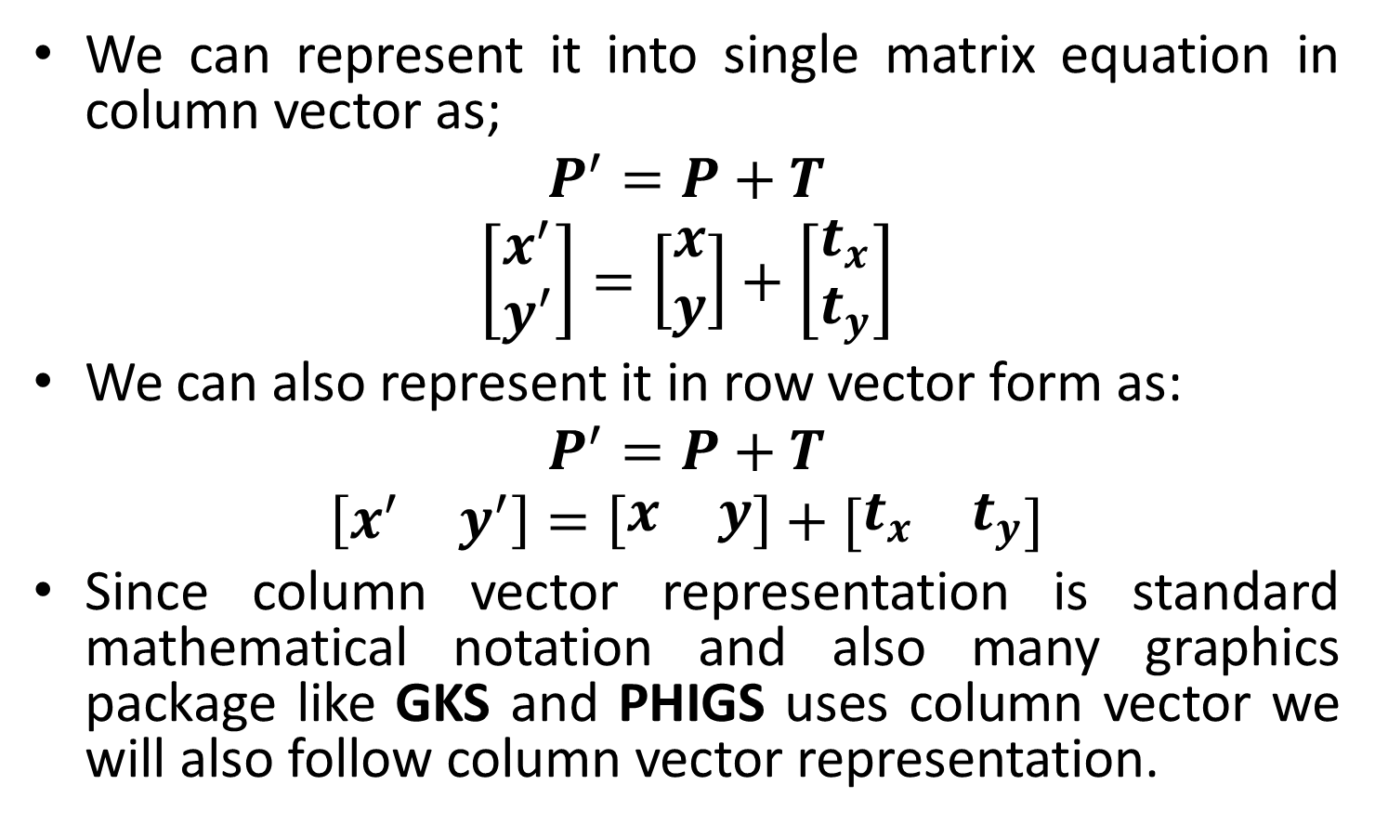
Contd.

Slide 7
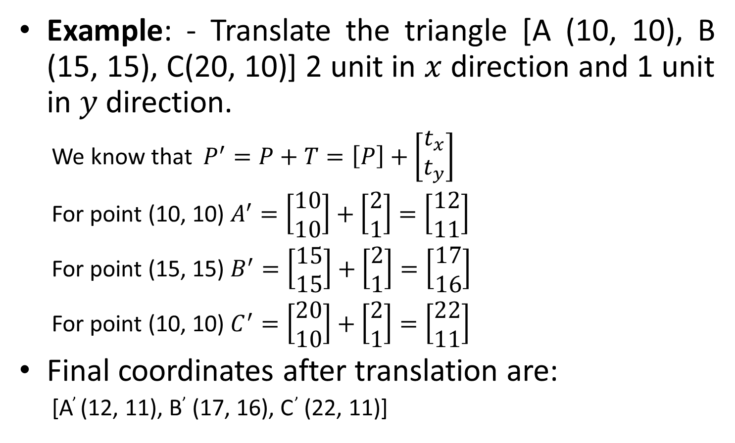
Translation Example

Slide 8
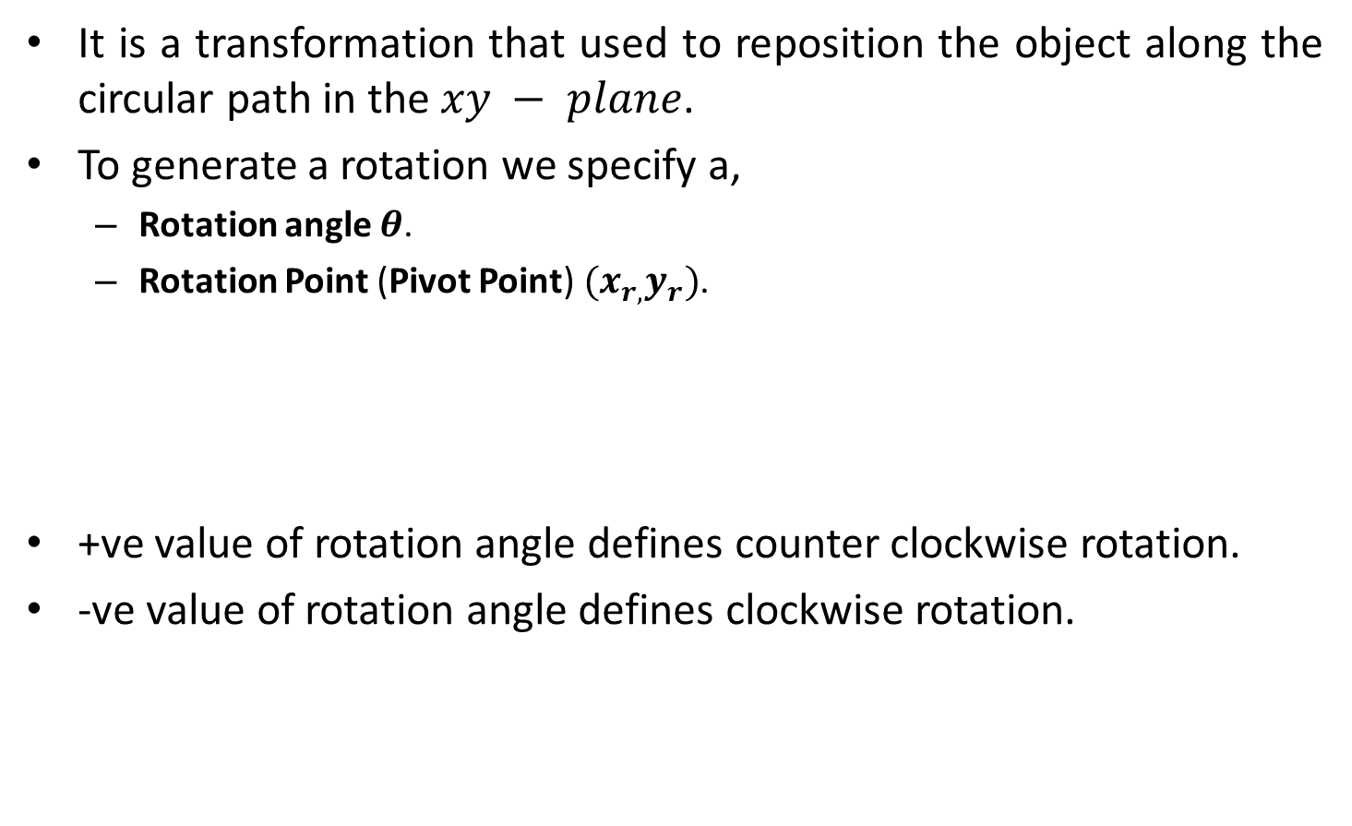
Rotation
(x',y')
(x,y)
θ
∅

Slide 9
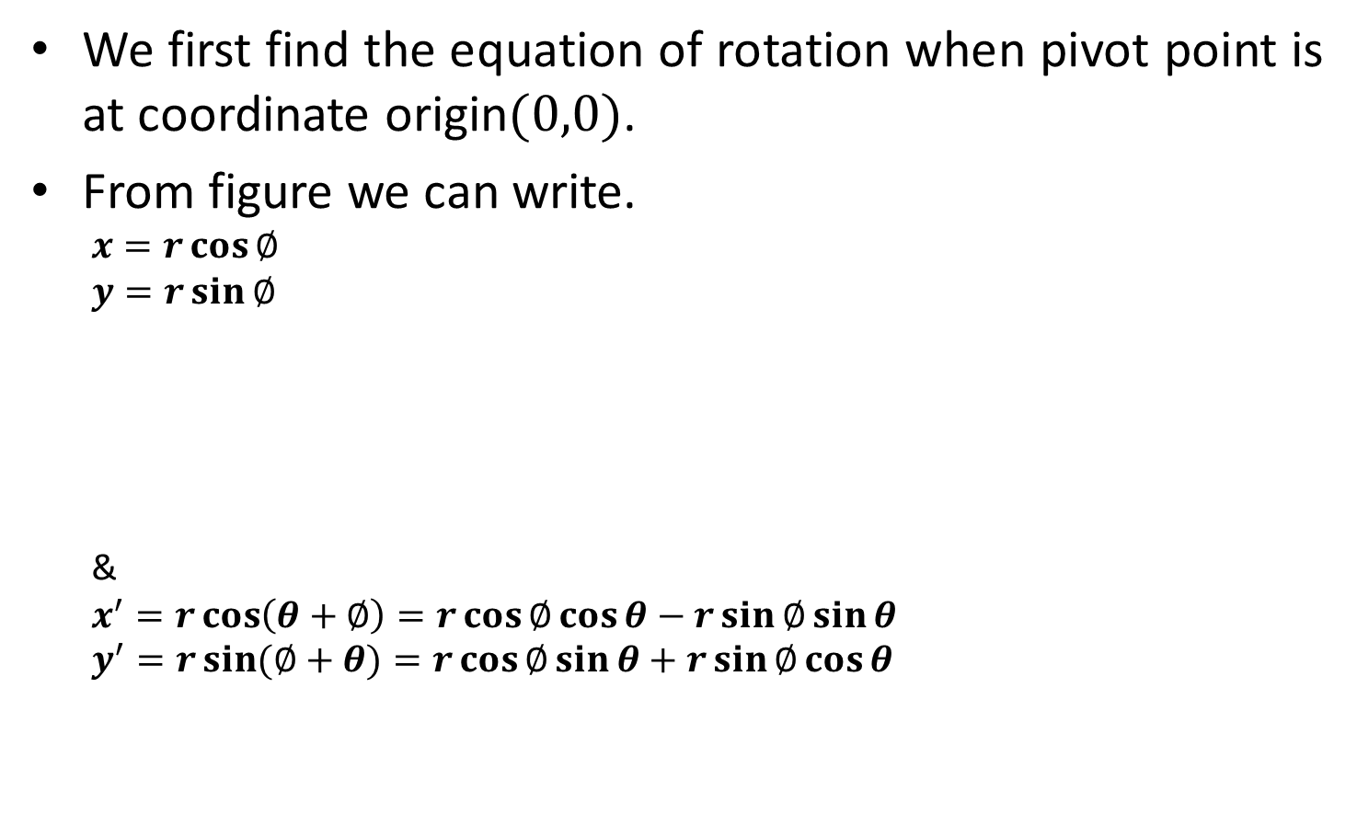
Rotation Equation
(x',y')
(x,y)
θ
∅

Slide 10
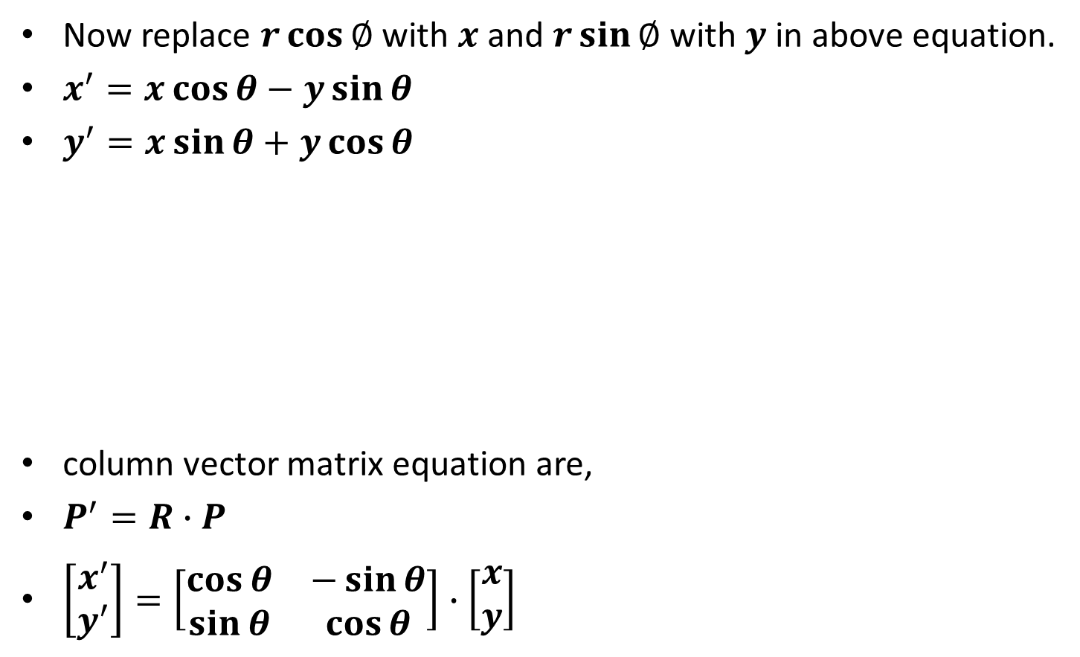
Contd.
(x',y')
(x,y)
θ
∅

Slide 11
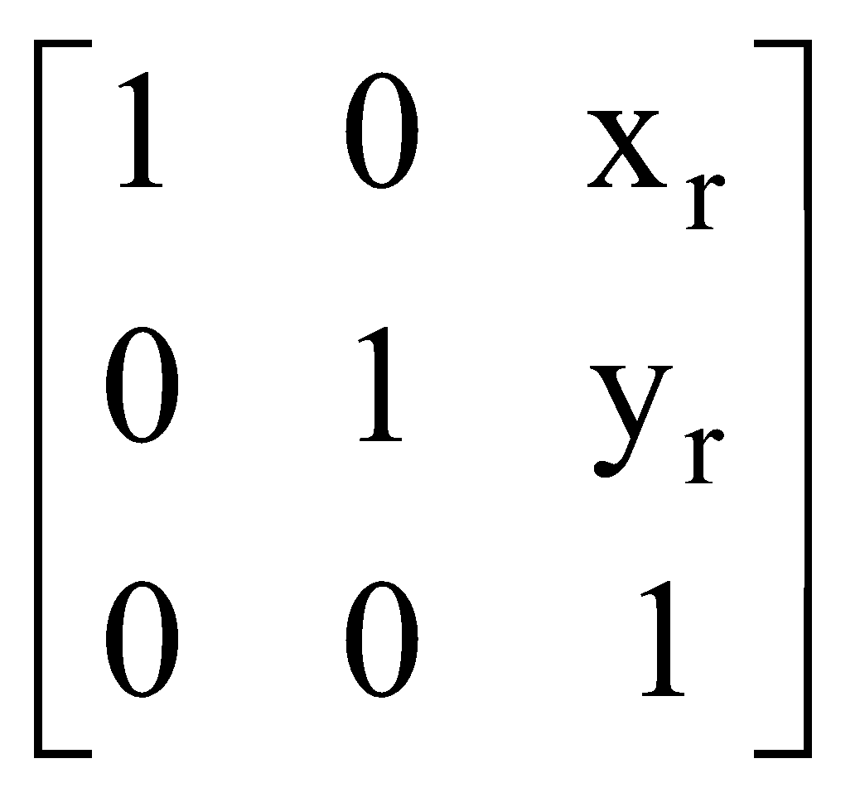
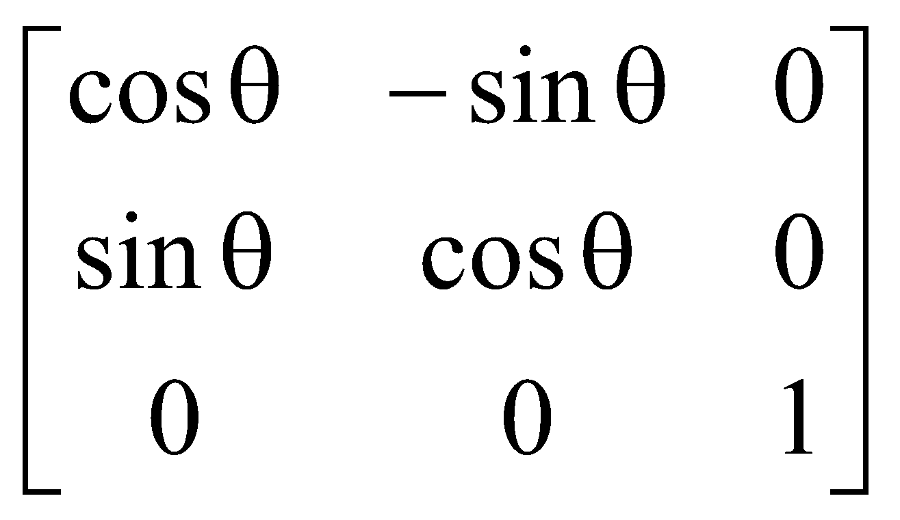
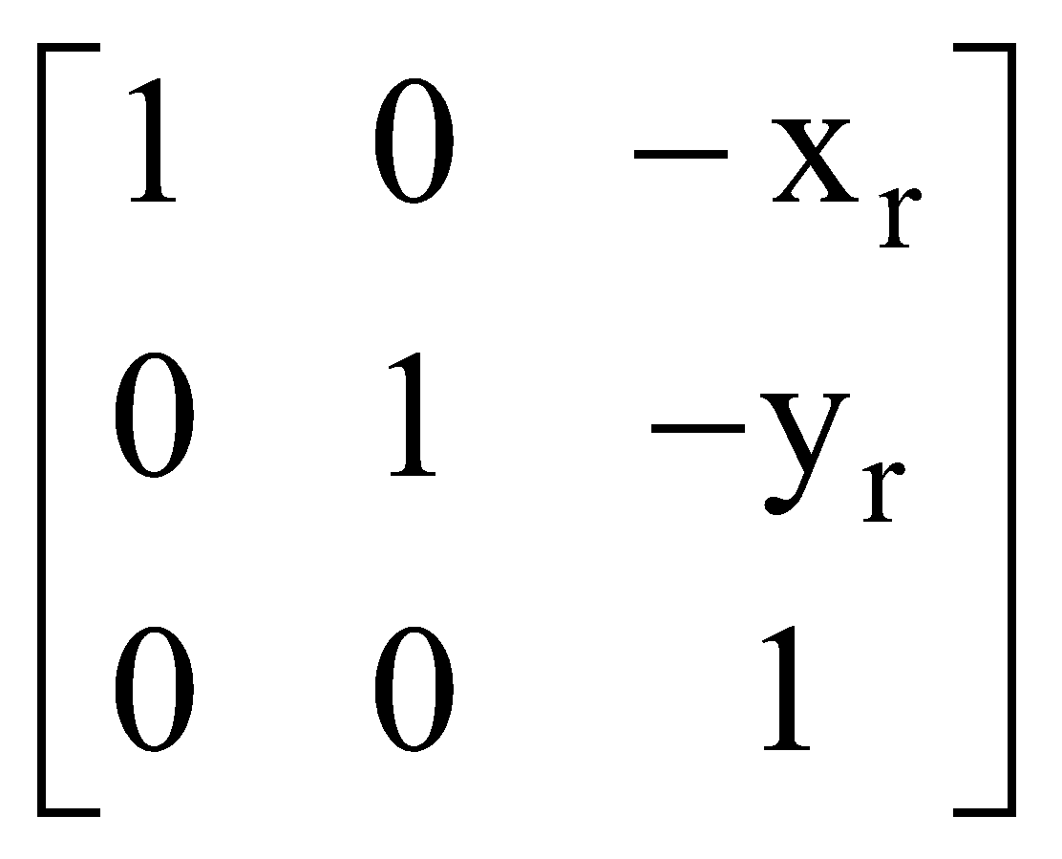
Rotation about arbitrary point
(x,y)
(x',y')
(x,y)
Arbitrary point
θ
∅
(x’’, y’’)
C.M = T‘ R_{θ} T

Slide 12
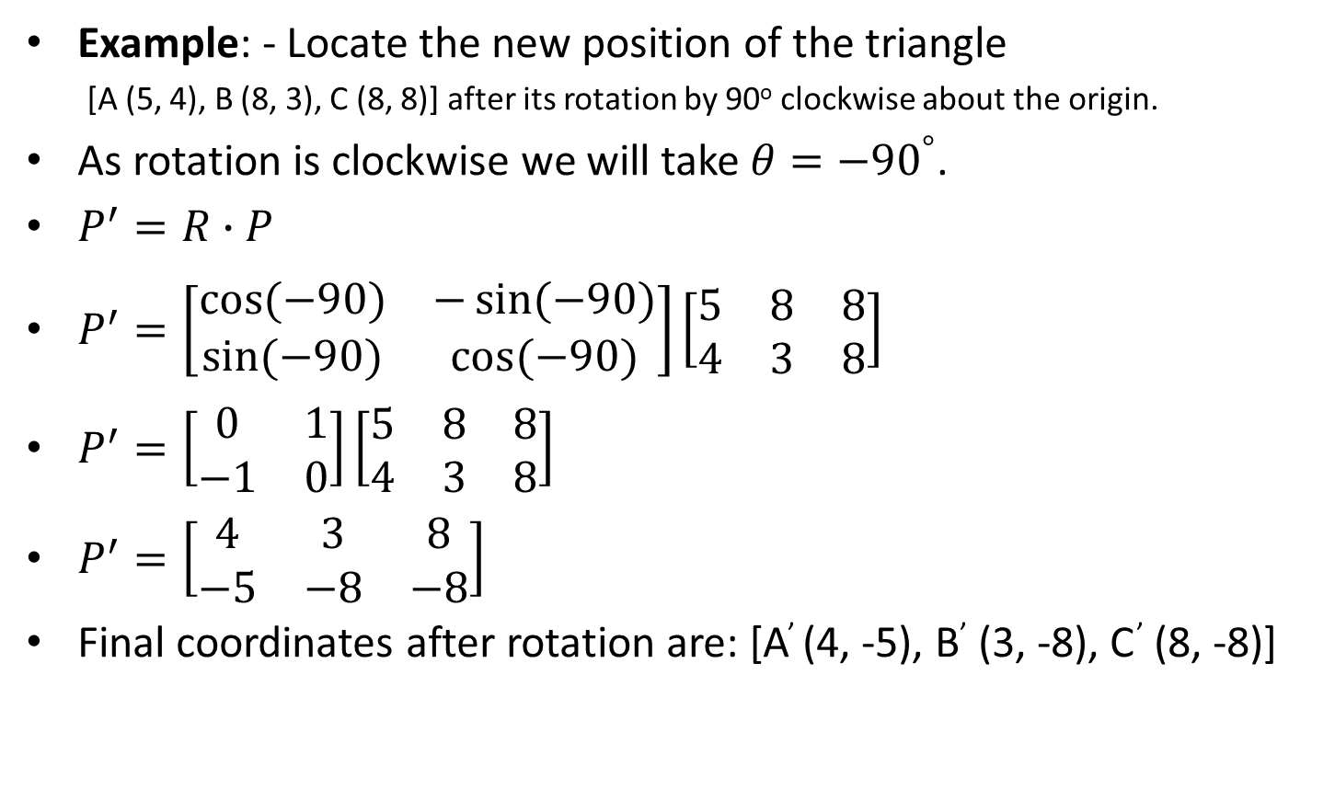
Rotation Example

Slide 13
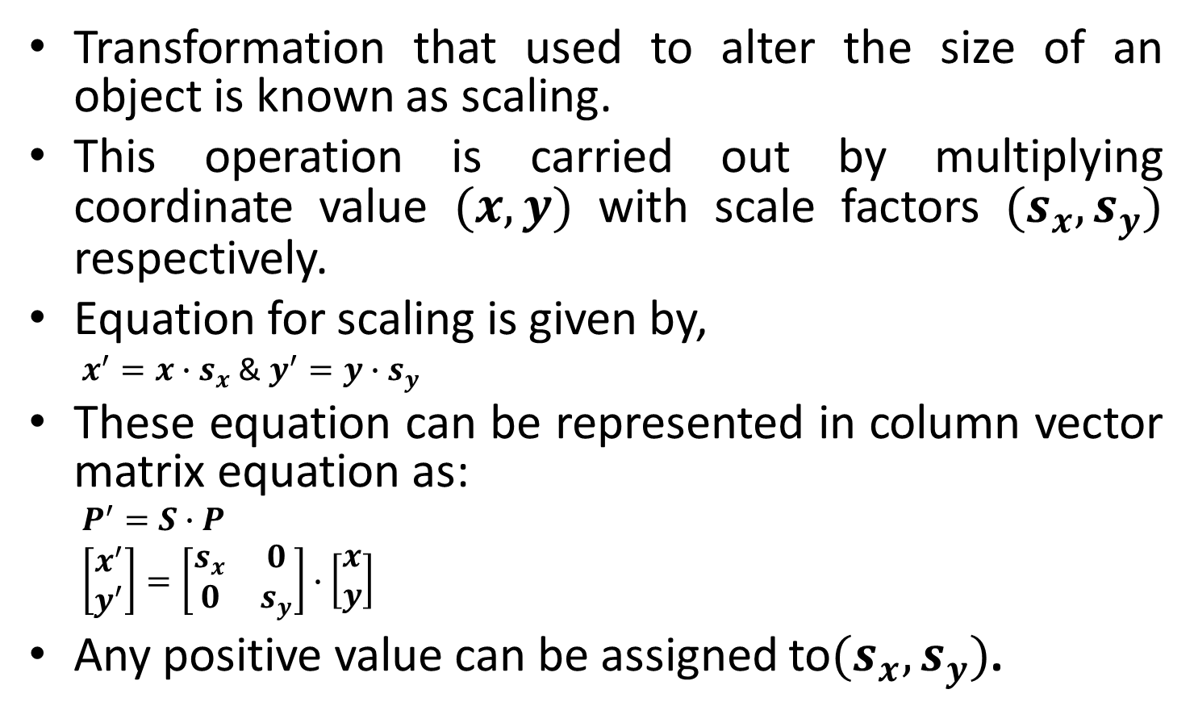
Scaling

Slide 14
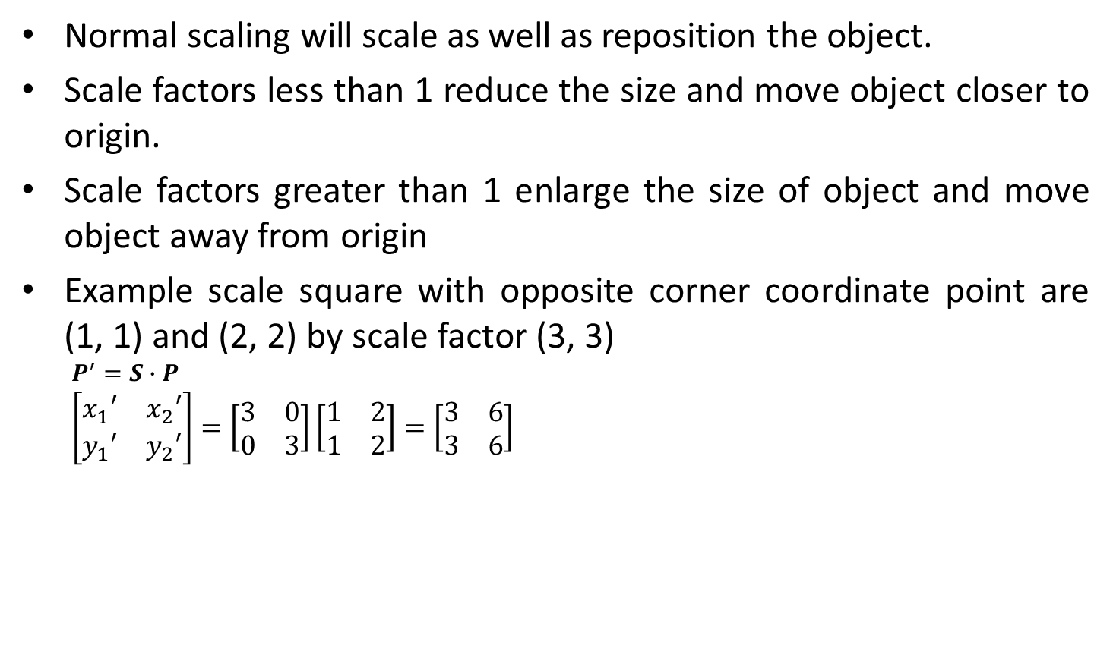
Contd.
3
1
1
3

Slide 15
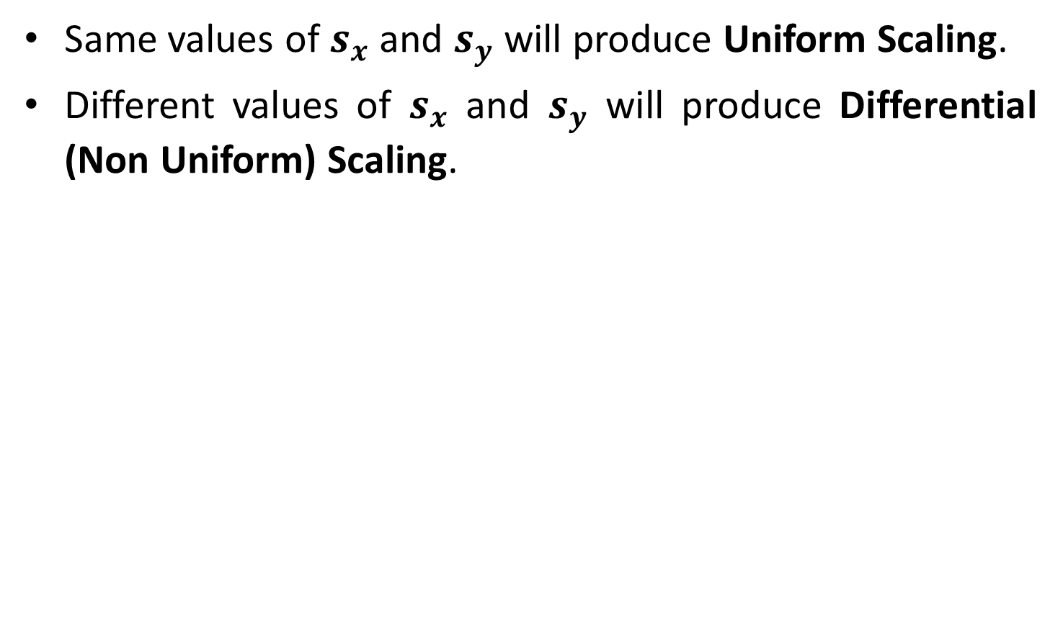
Contd.
Uniform Scaling
Differential Scaling

Slide 16
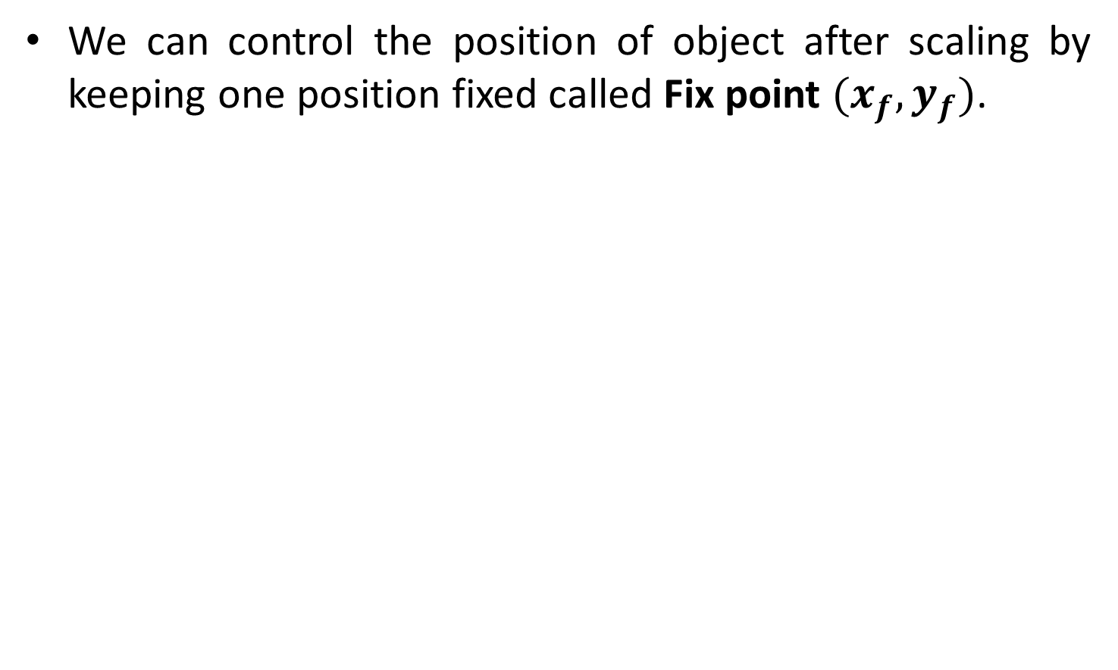
Fixed Point Scaling
Fixed Point

Slide 17
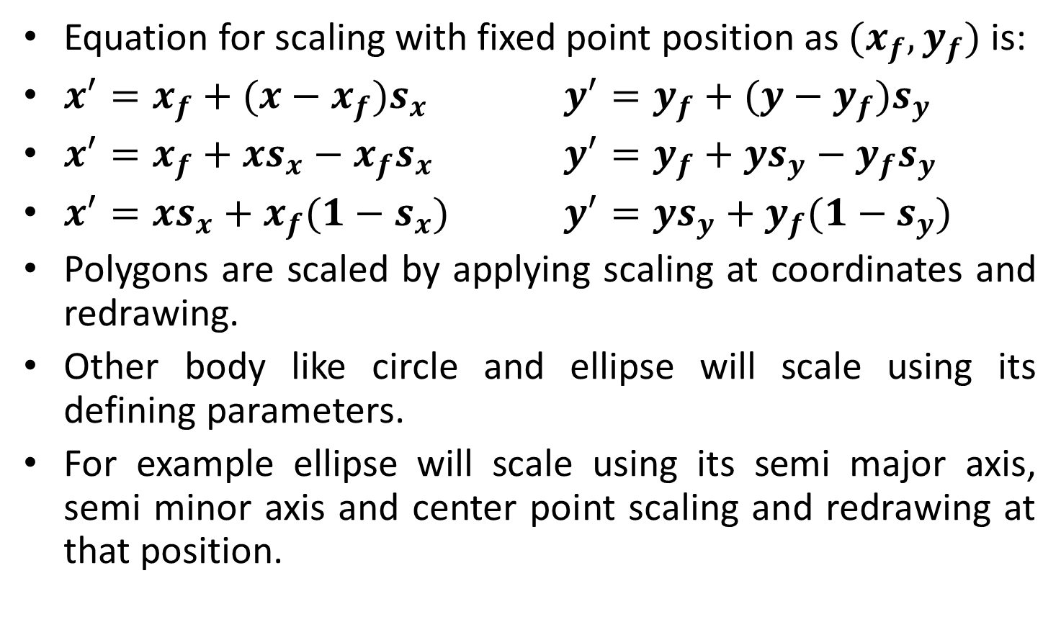
Fixed Point Scaling Equation

Slide 18
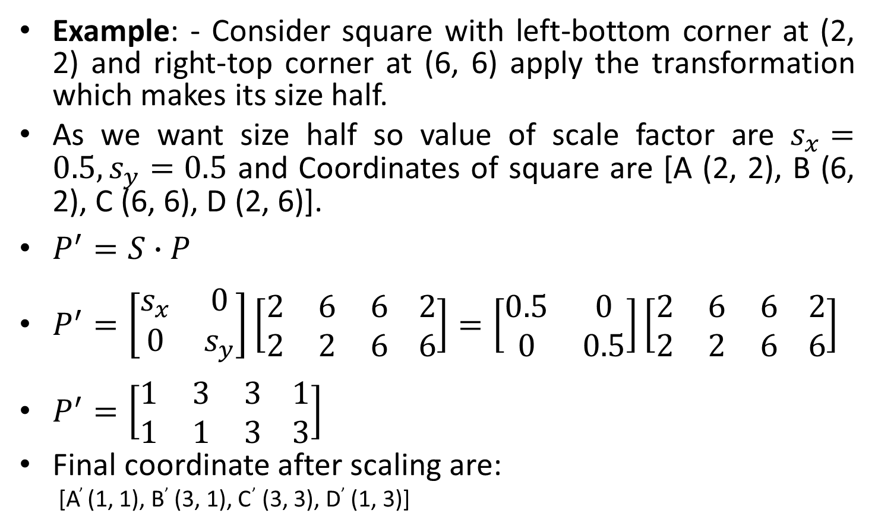
Scaling Example

Slide 19
Matrix Representation and Homogeneous Coordinates
Many graphics application involves sequence of geometric transformations.
For example in design and picture construction application we perform Translation, Rotation, and scaling to fit the picture components into their proper positions.
For efficient processing we will reformulate transformation sequences.

Slide 20
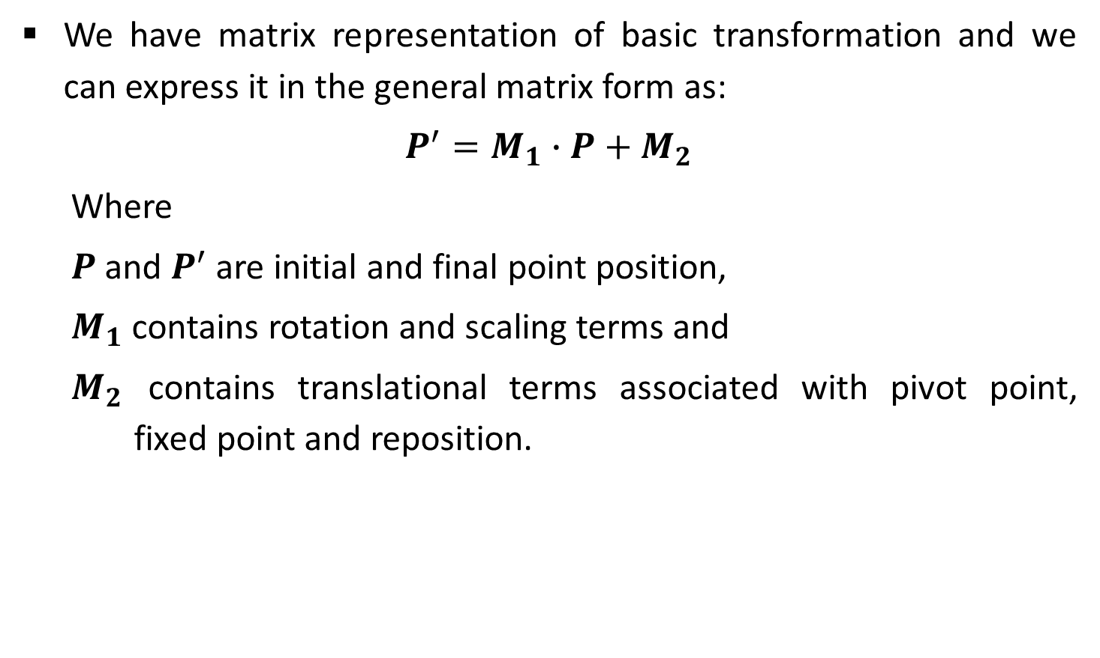
Contd.

Slide 21
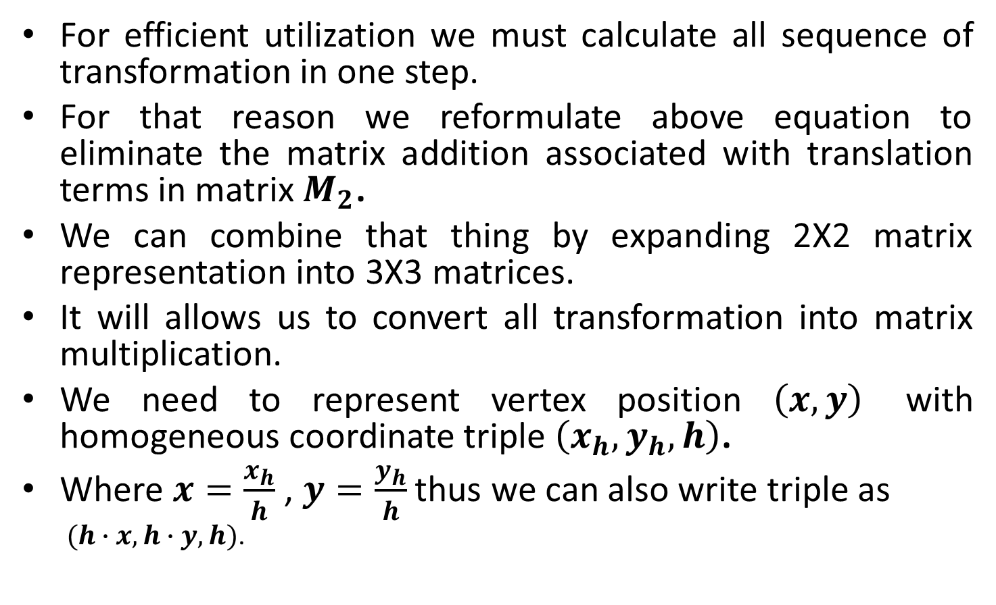
Contd.

Slide 22
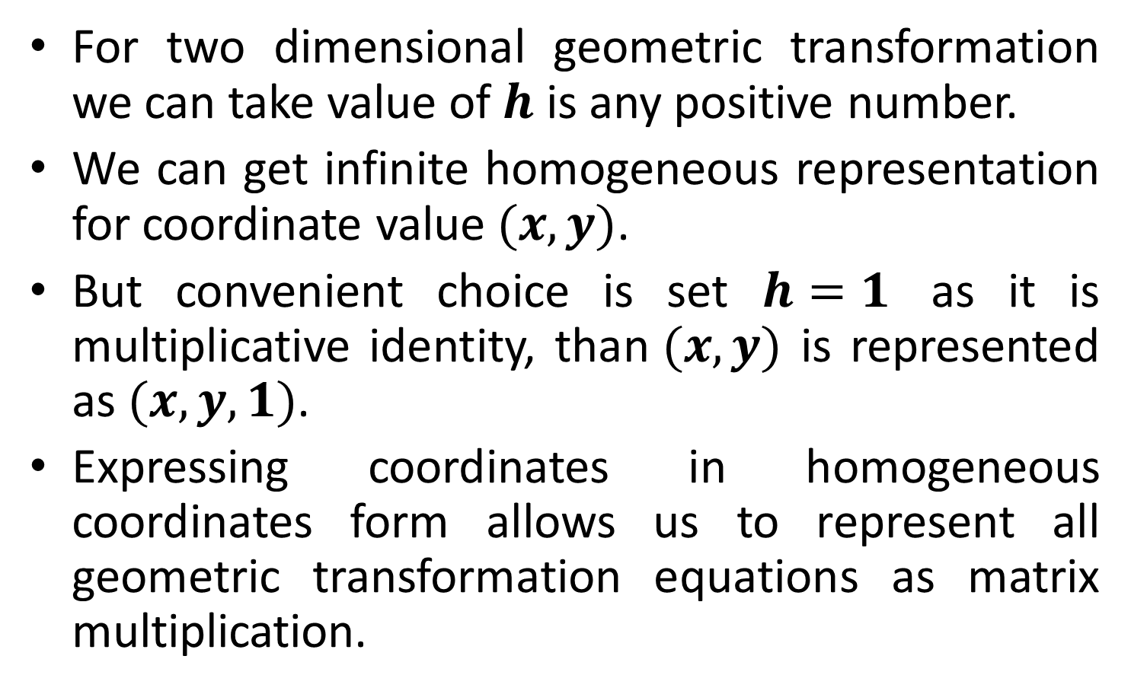
Contd.

Slide 23
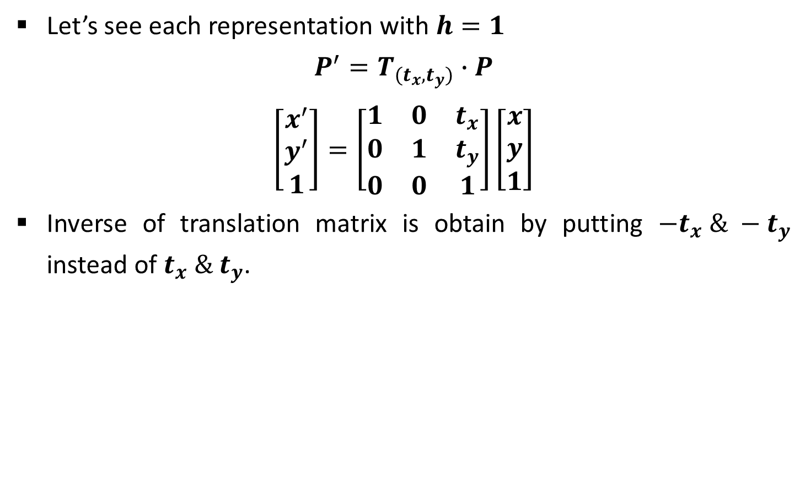
Homogeneous Matrix for Translation

Slide 24
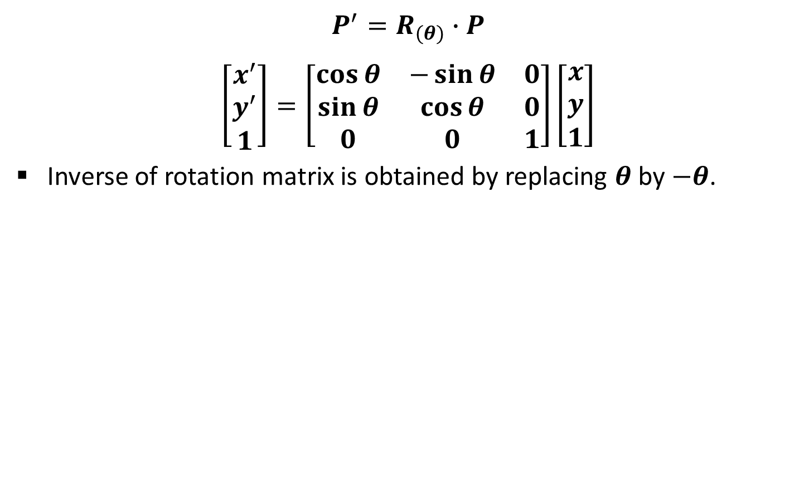
Homogeneous Matrix for Rotation

Slide 25
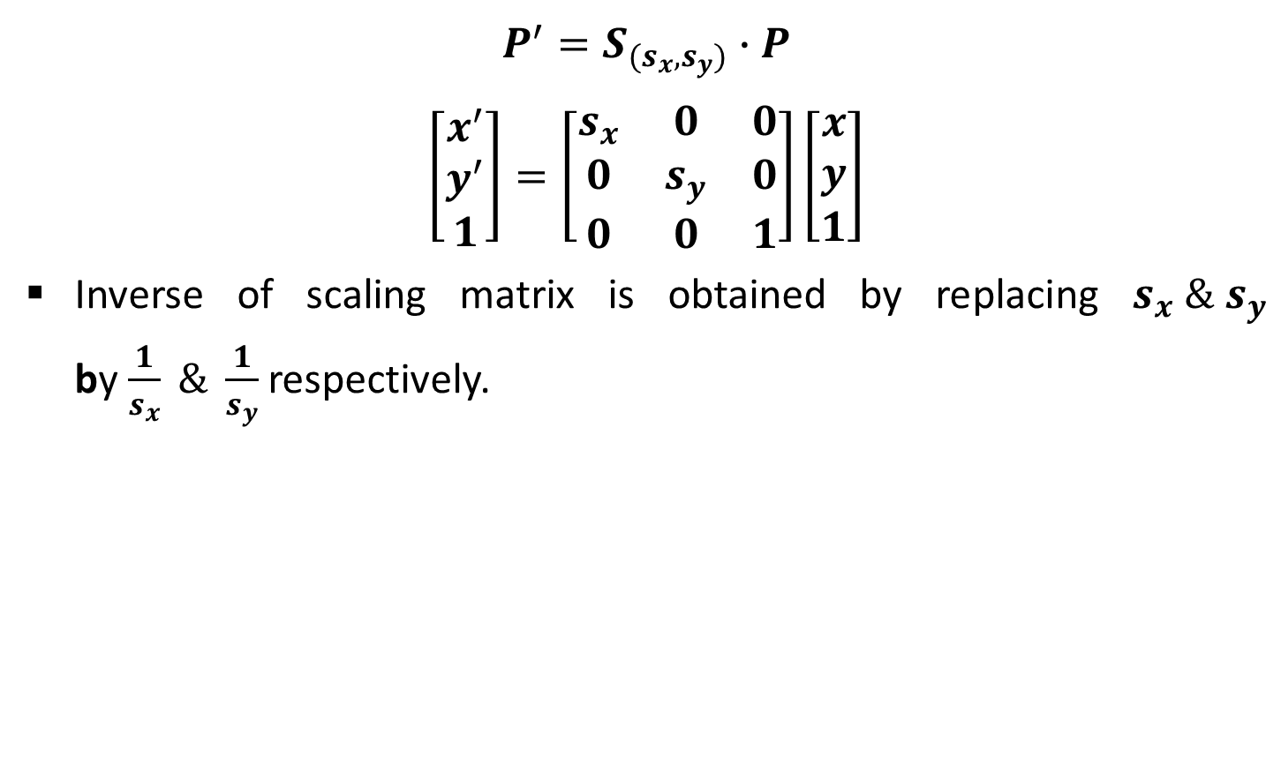
Homogeneous Matrix for Scaling

Slide 26
Composite Transformation
In practice we need to apply more than one transformations to get desired result.
It is time consuming to apply transformation one by one on each point of object.
So first we multiply all matrix of required transformations which is known as composite transformation matrix.
Than we use composite transformation matrix to transform object.
For column matrix representation, we form composite transformations by multiplying matrices from right to left.

Slide 27
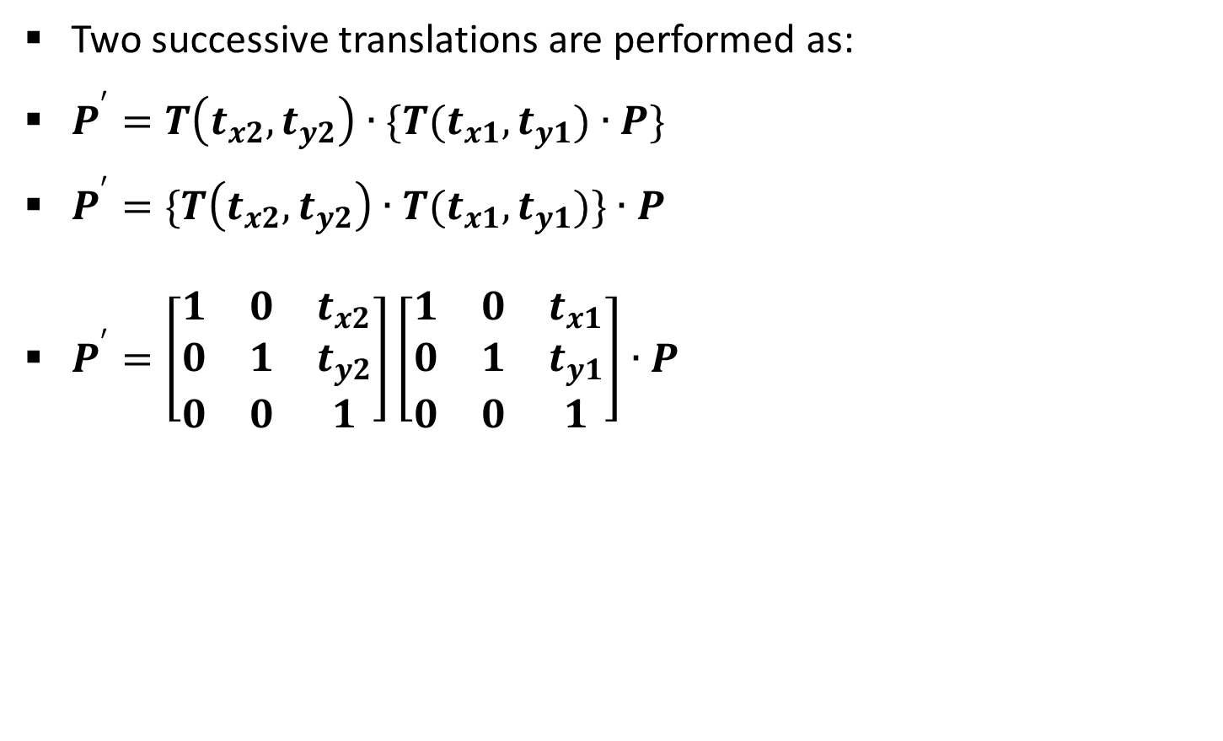
Multiple Translations

Slide 28
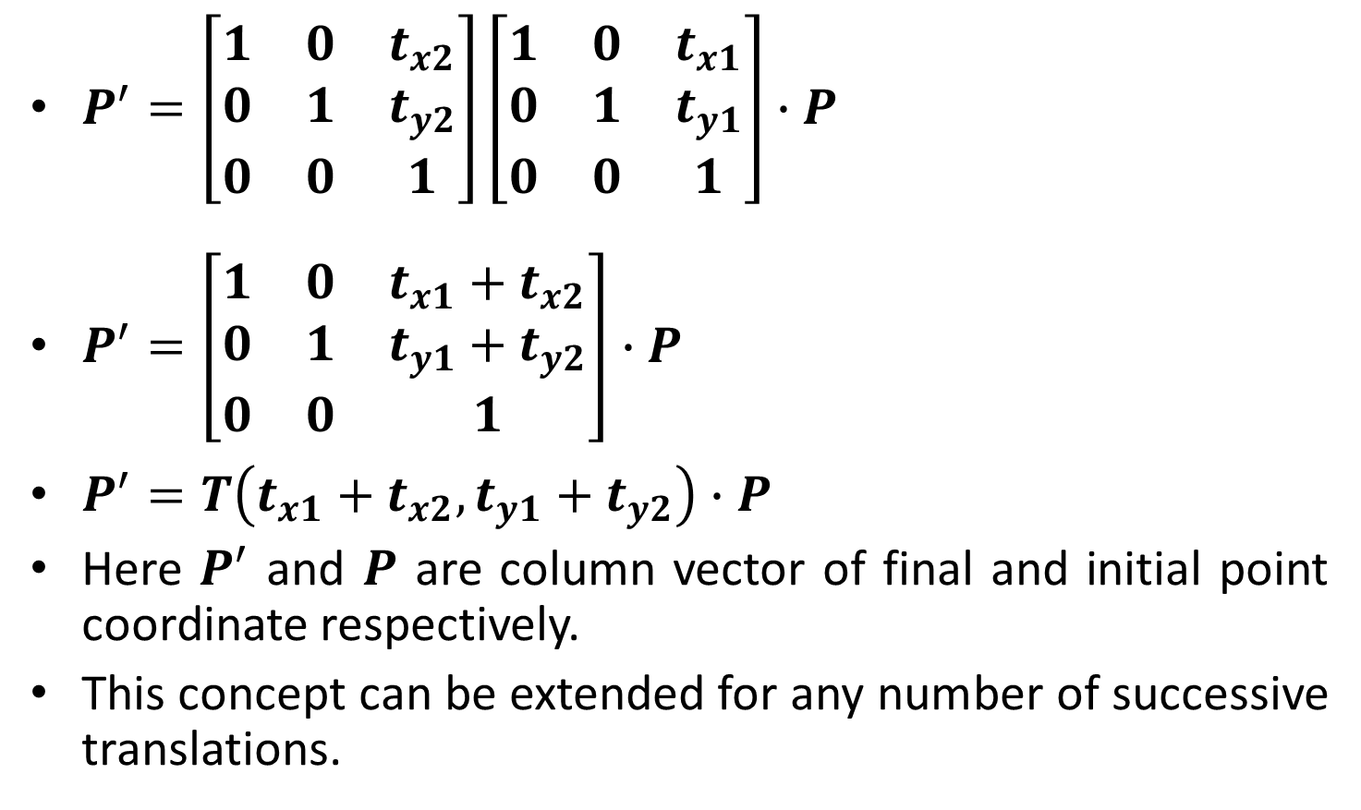
Contd.

Slide 29
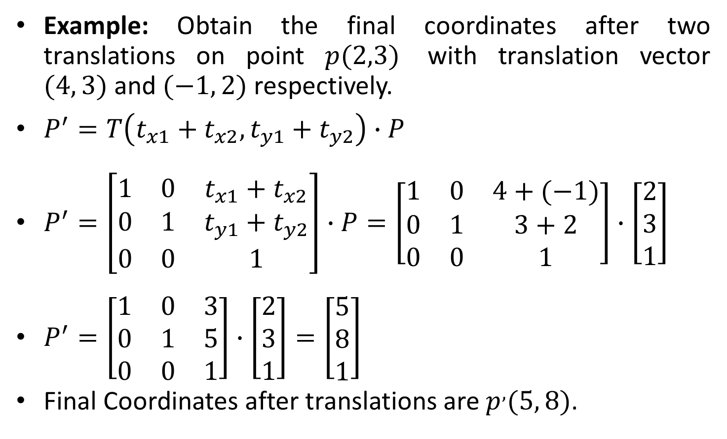
Multiple Translations Example

Slide 30
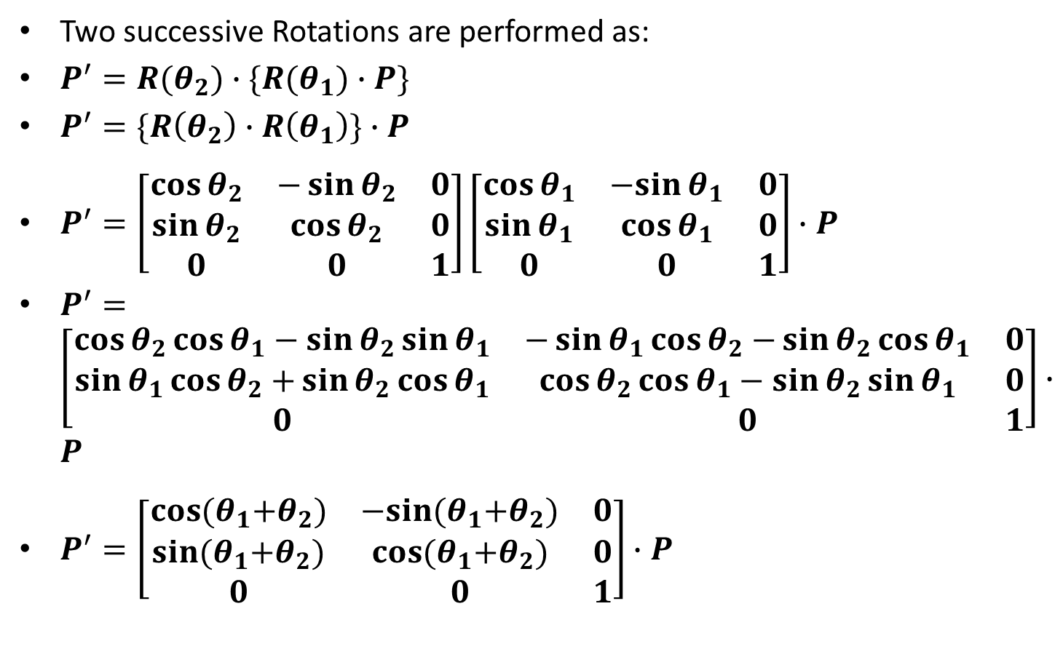
Multiple Rotations

Slide 31
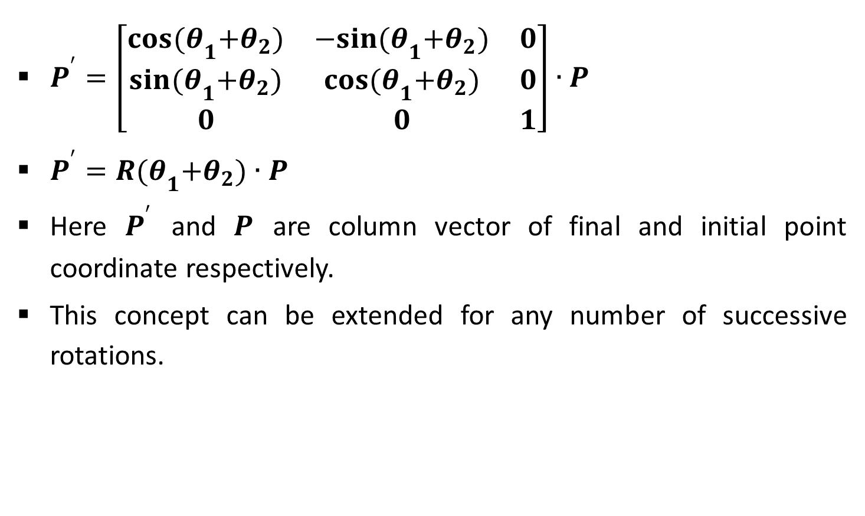
Contd.

Slide 32
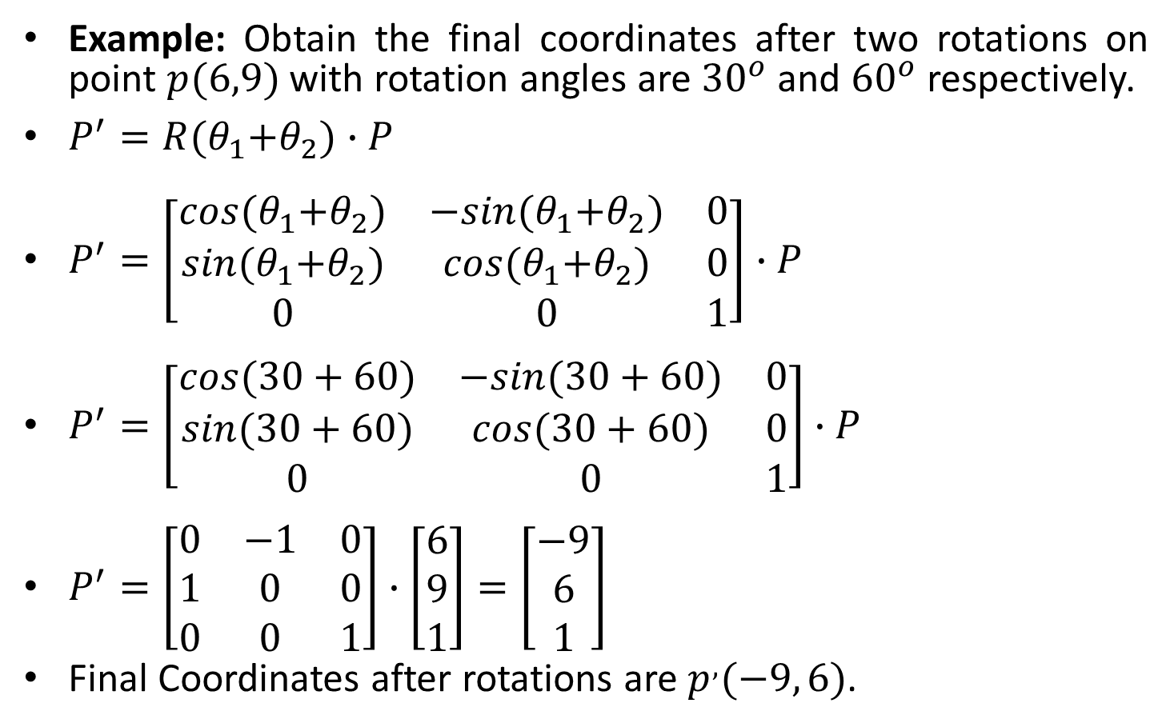
Multiple Rotations Example

Slide 33
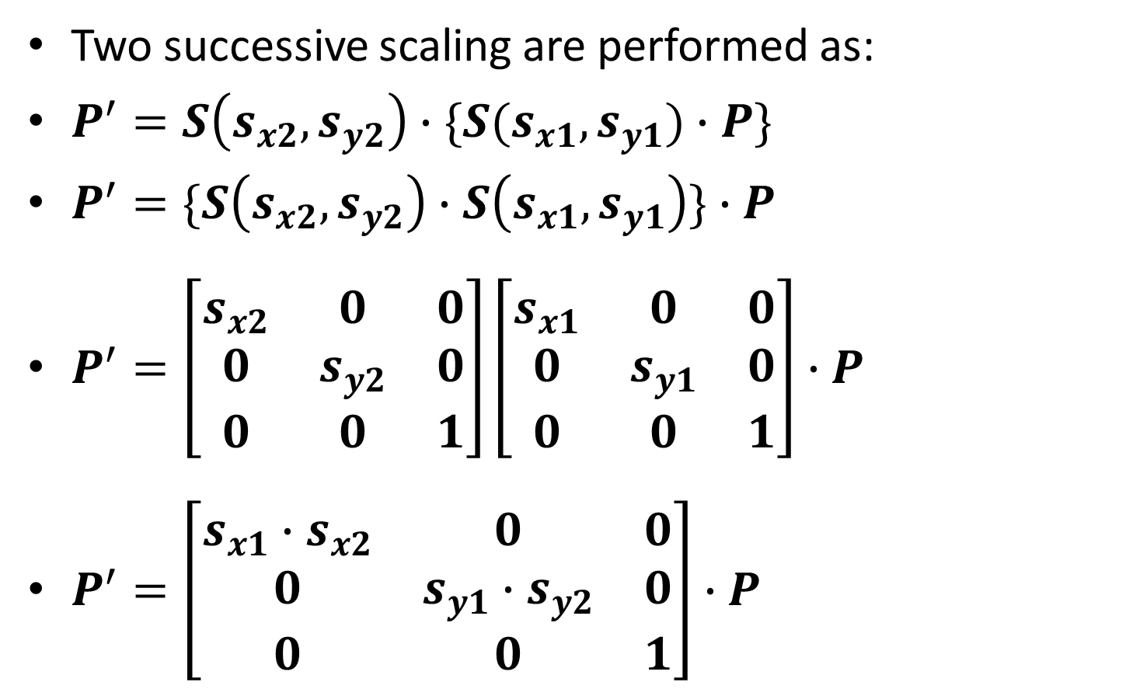
Multiple Scaling

Slide 34
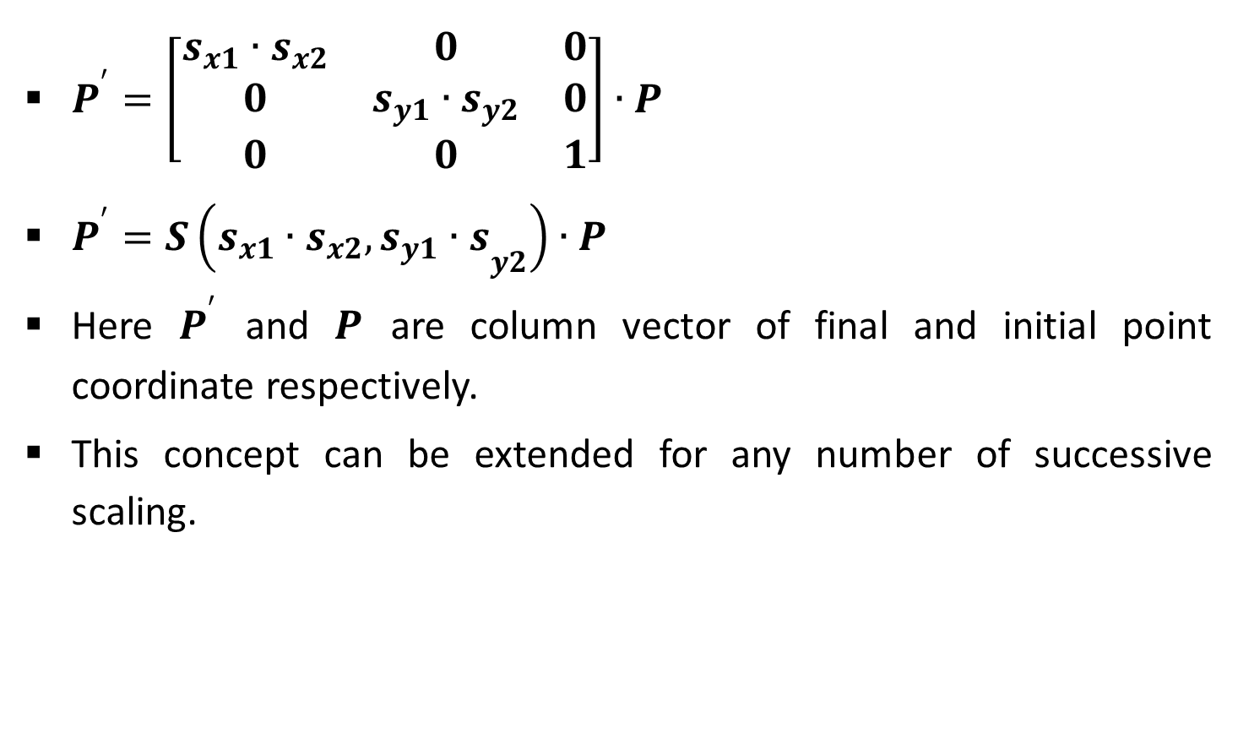
Contd.

Slide 35
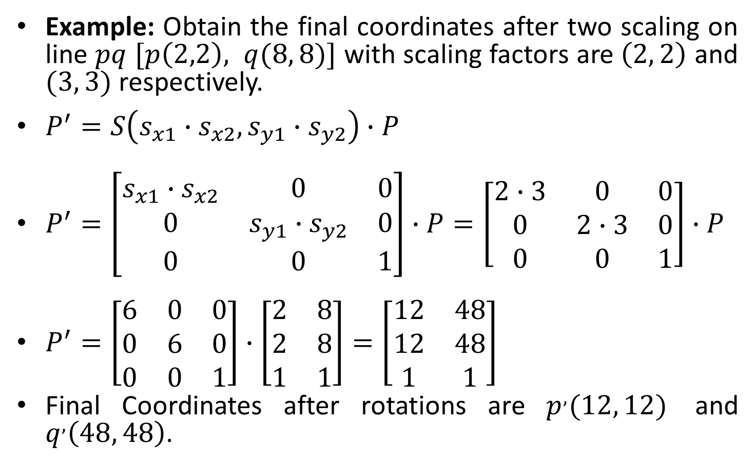
Multiple Scaling Example

Slide 36
General Pivot-Point Rotation
For rotating object about arbitrary point called pivot point we need to apply following sequence of transformation.
Translate the object so that the pivot-point coincides with the coordinate origin.
Rotate the object about the coordinate origin with specified angle.
Translate the object so that the pivot-point is returned to its original position (i.e. Inverse of step-1).

Slide 37
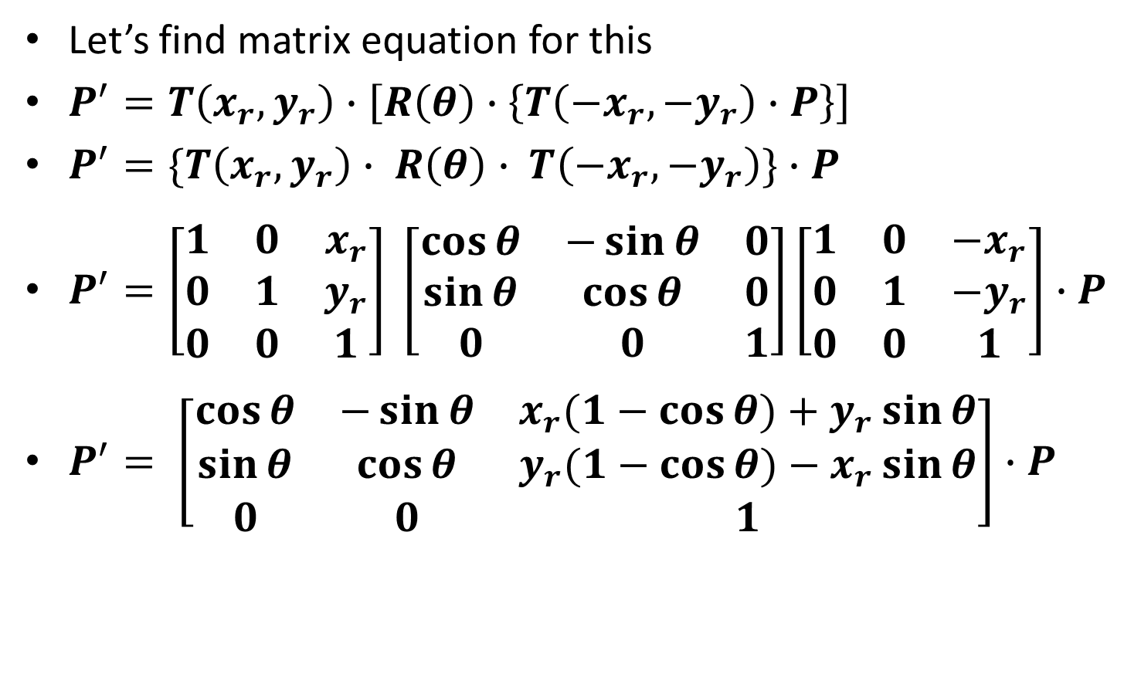
General Pivot-Point Rotation Equation

Slide 38
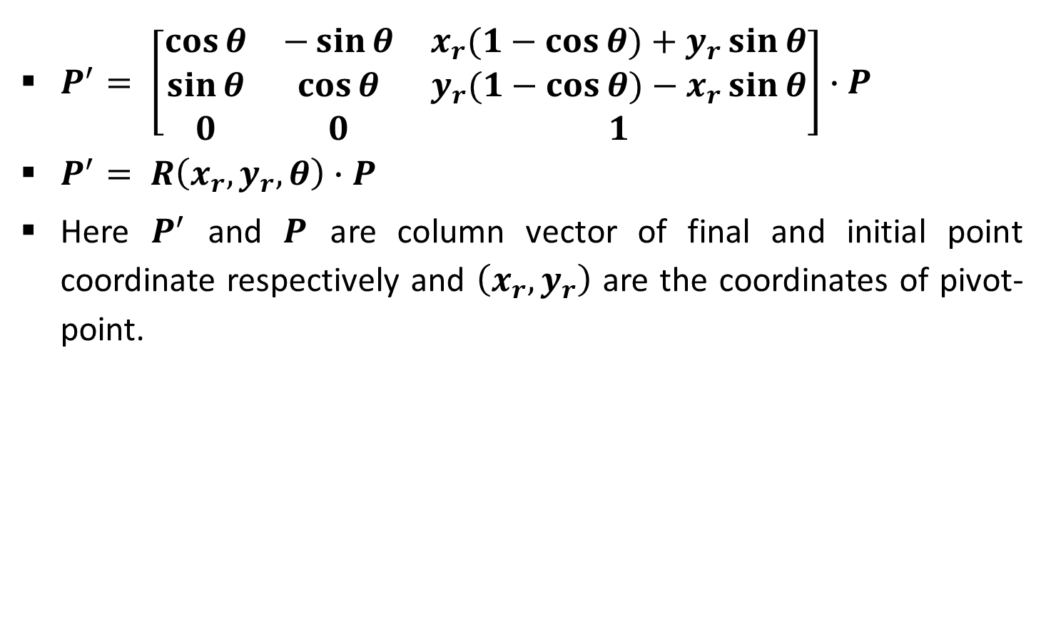
Contd.

Slide 39
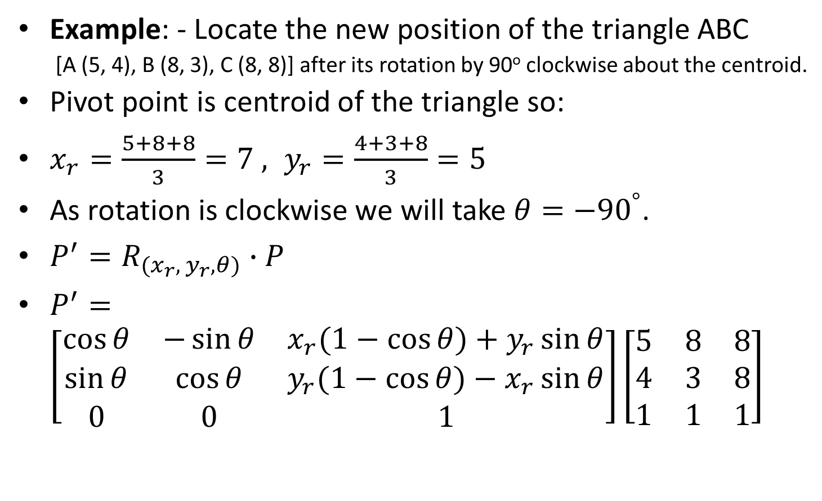
General Pivot-Point Rotation Example

Slide 40
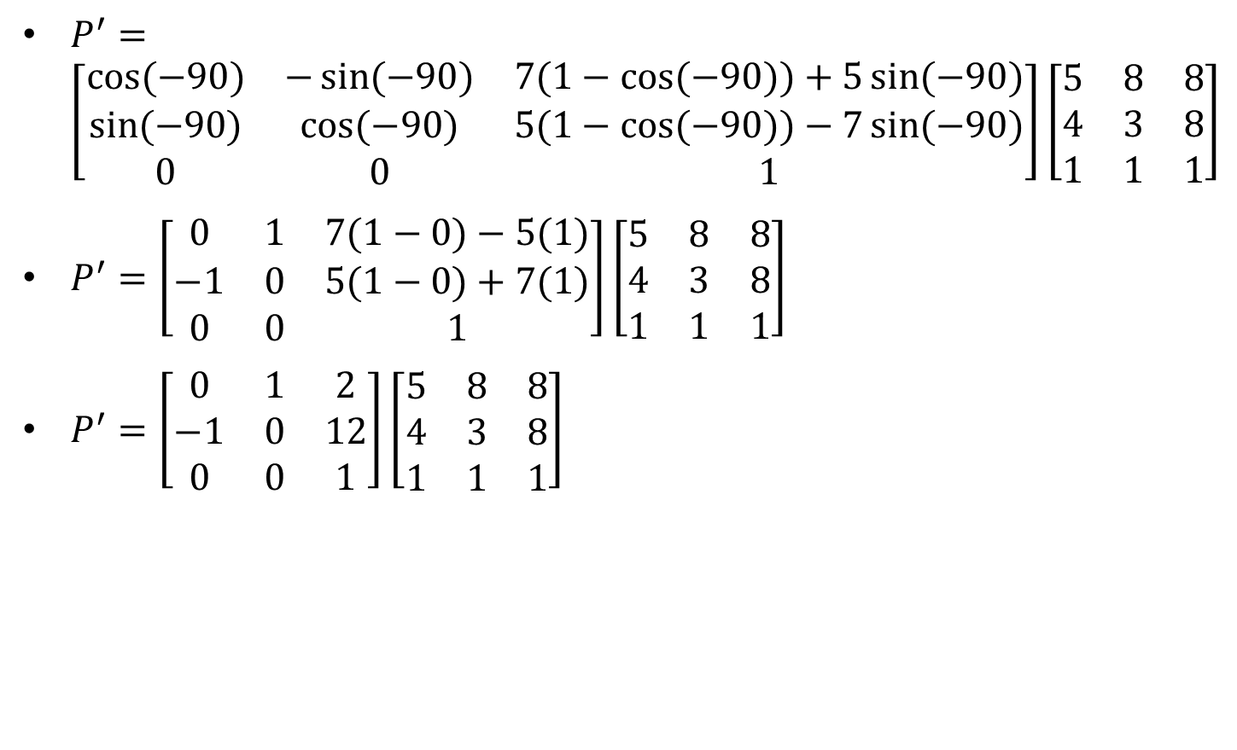
Contd.

Slide 41
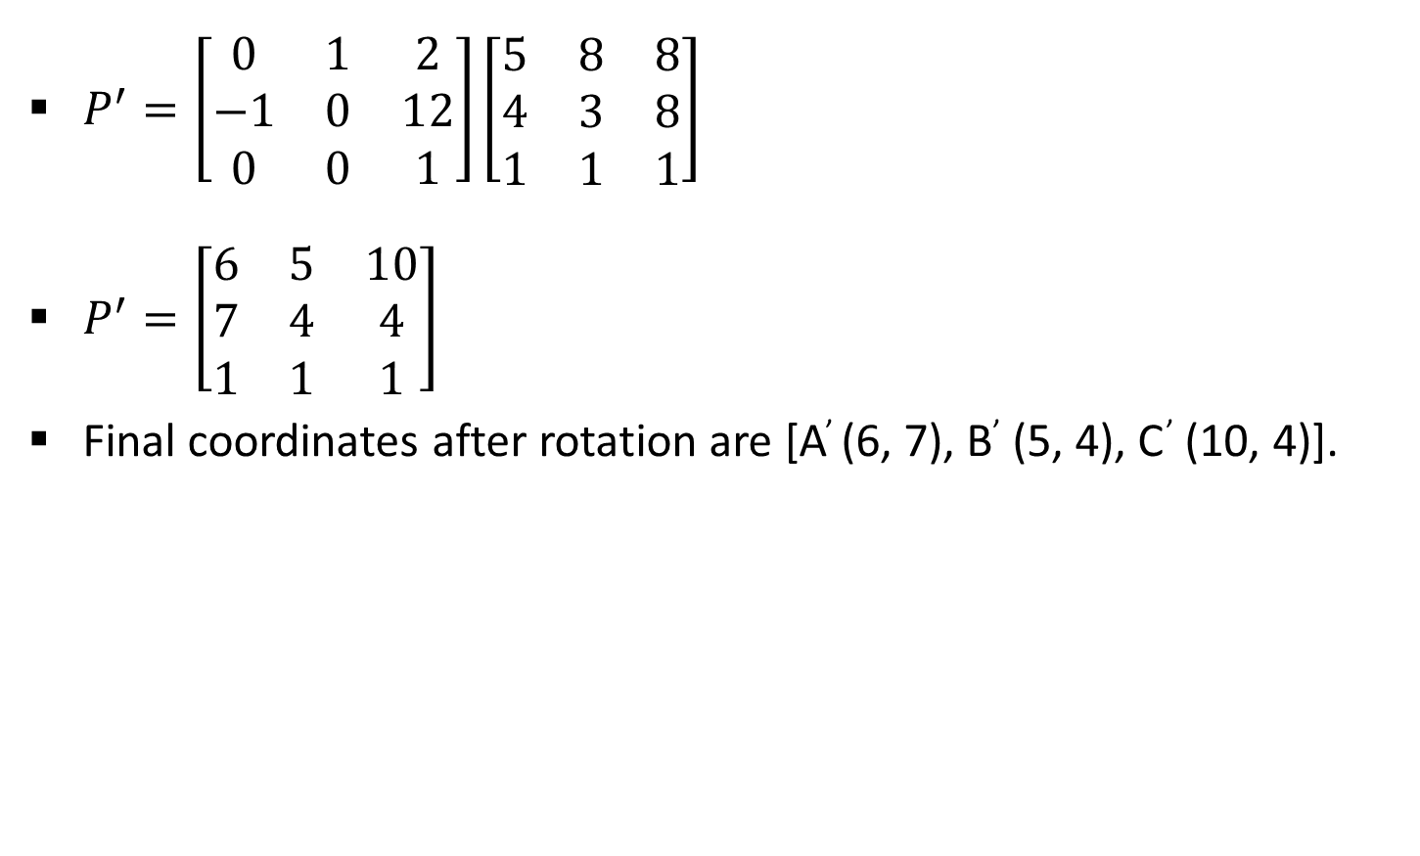
Contd.

Slide 42
General Fixed-Point Scaling
For scaling object with position of one point called fixed point will remains same, we need to apply following sequence of transformation.
Translate the object so that the fixed-point coincides with the coordinate origin.
Scale the object with respect to the coordinate origin with specified scale factors.
Translate the object so that the fixed-point is returned to its original position (i.e. Inverse of step-1).

Slide 43
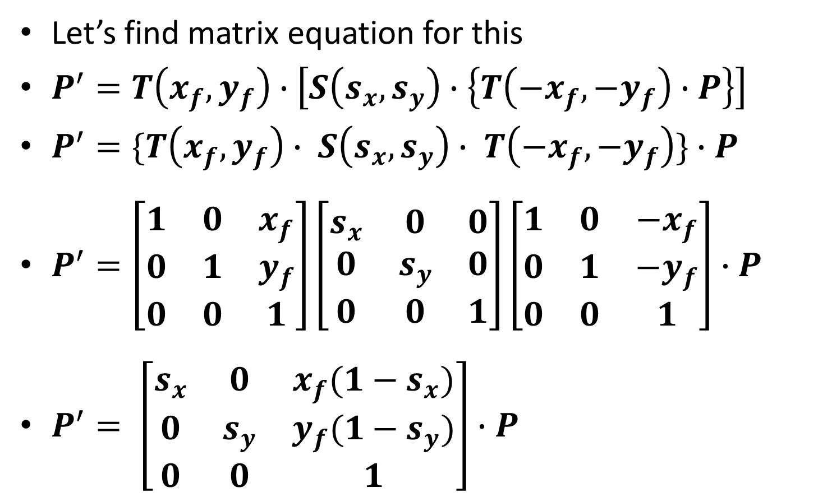
General Fixed-Point Scaling Equation

Slide 44
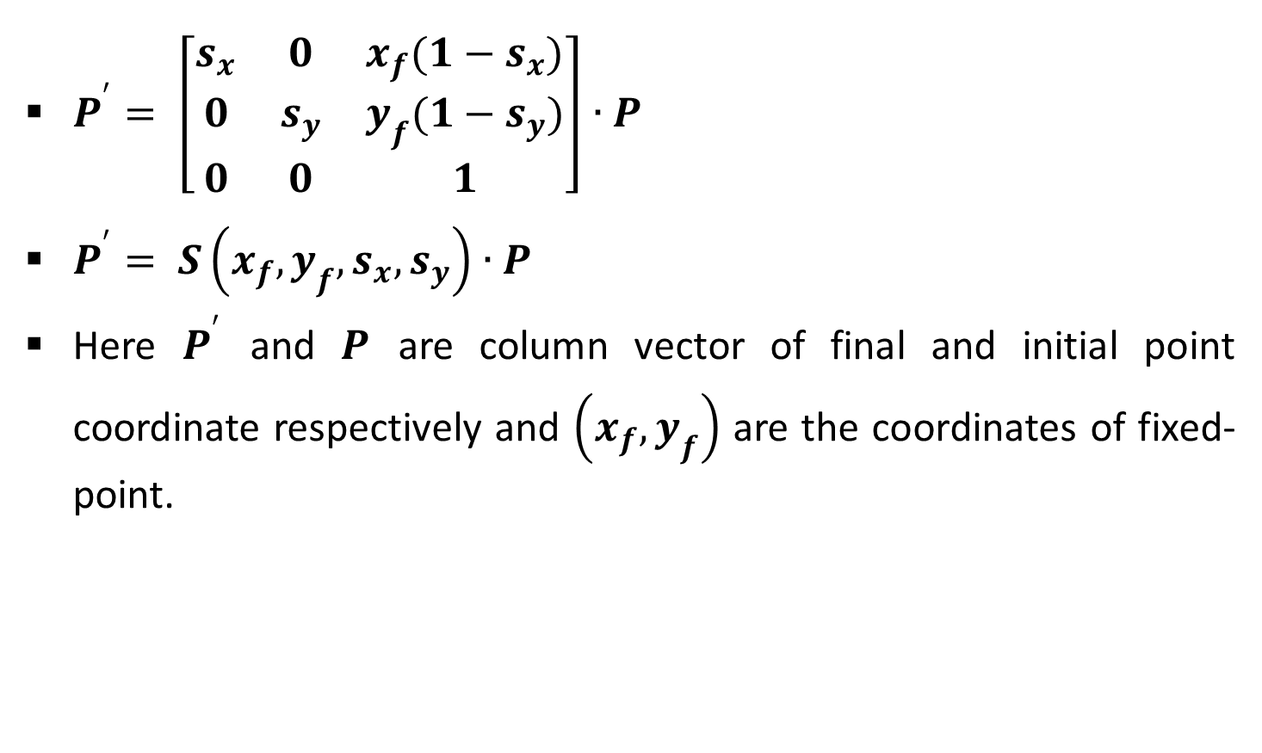
Contd.

Slide 45
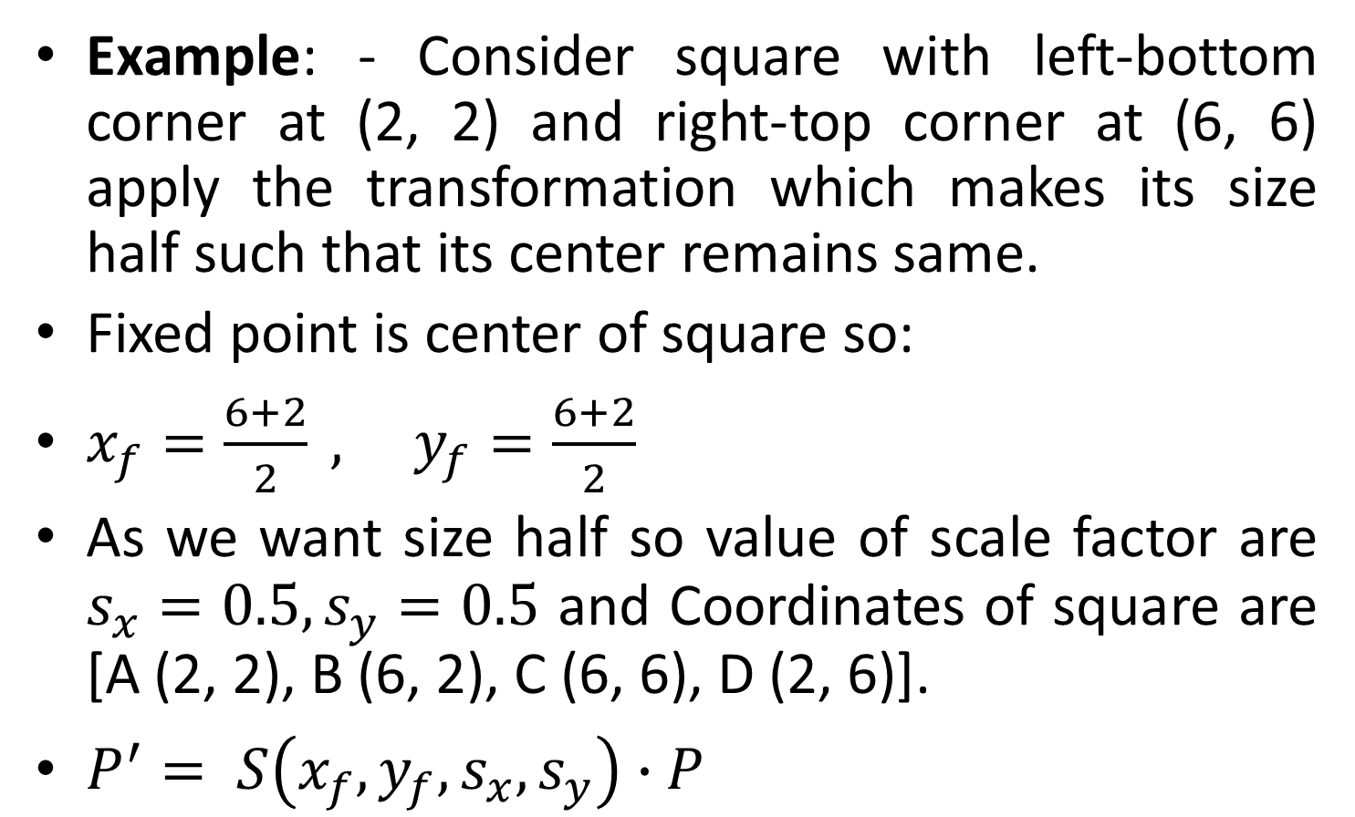
General Fixed-Point Scaling Example

Slide 46
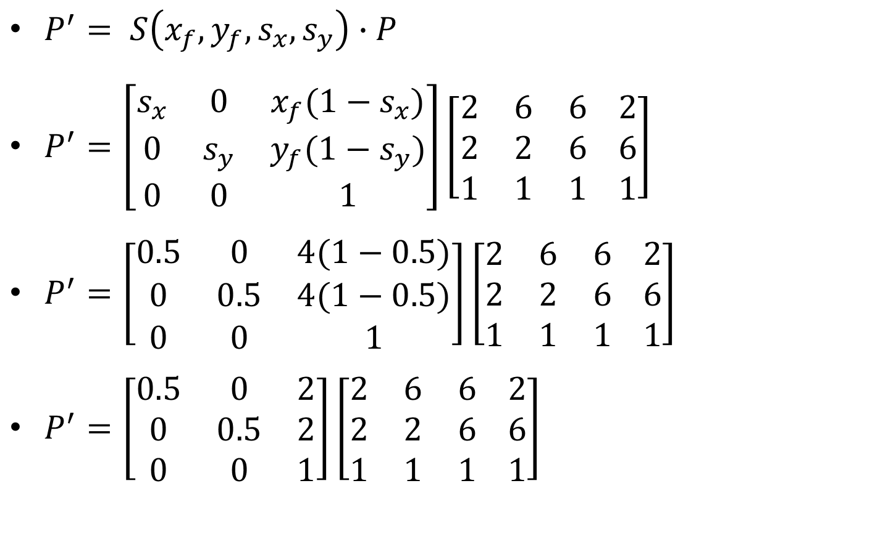
Contd.

Slide 47
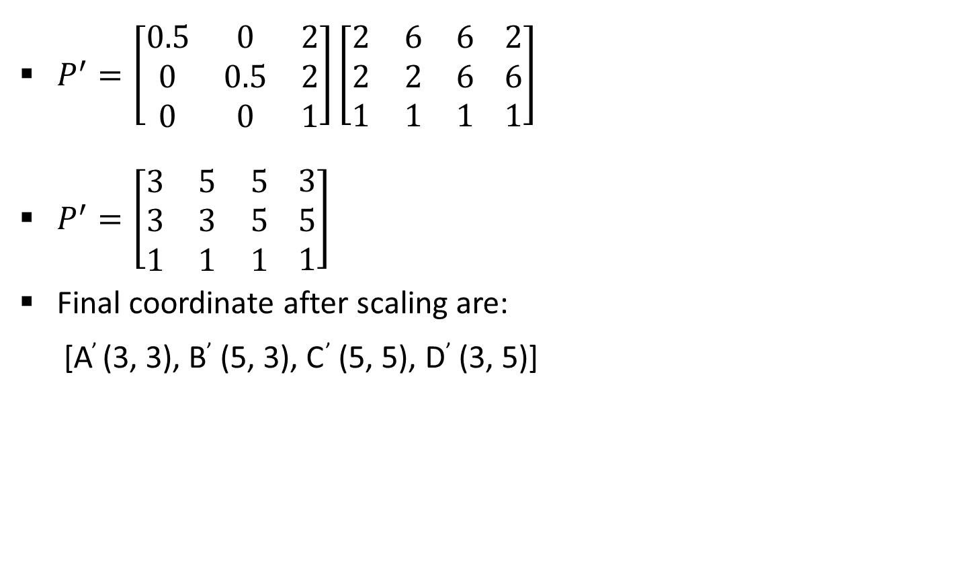
Contd.

Slide 48
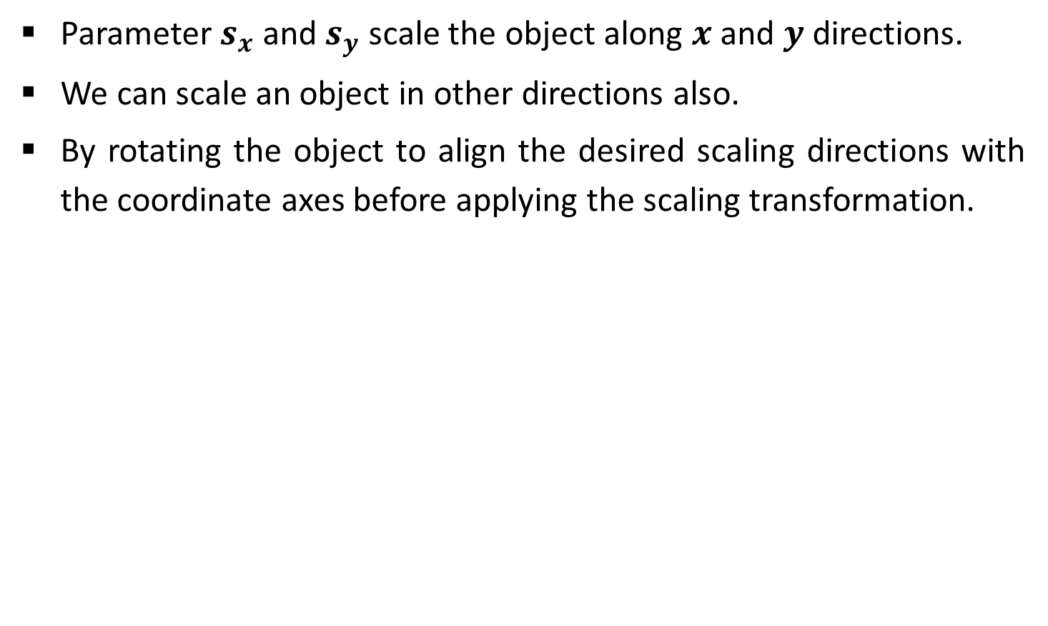
General Scaling Directions

Slide 49
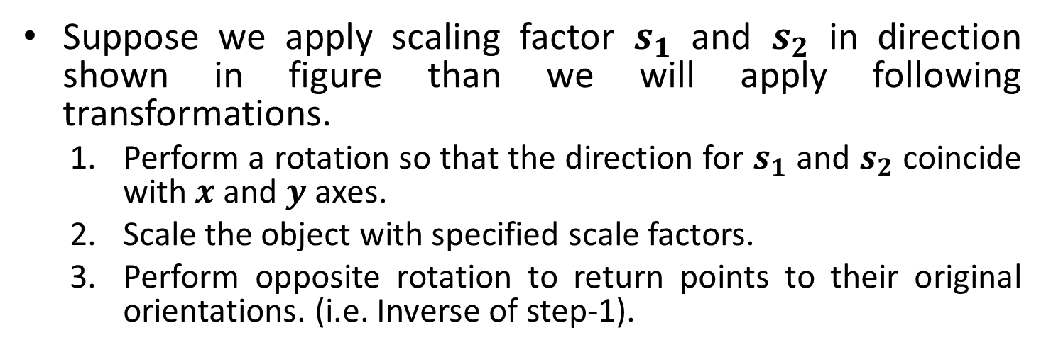
Contd.

Slide 50
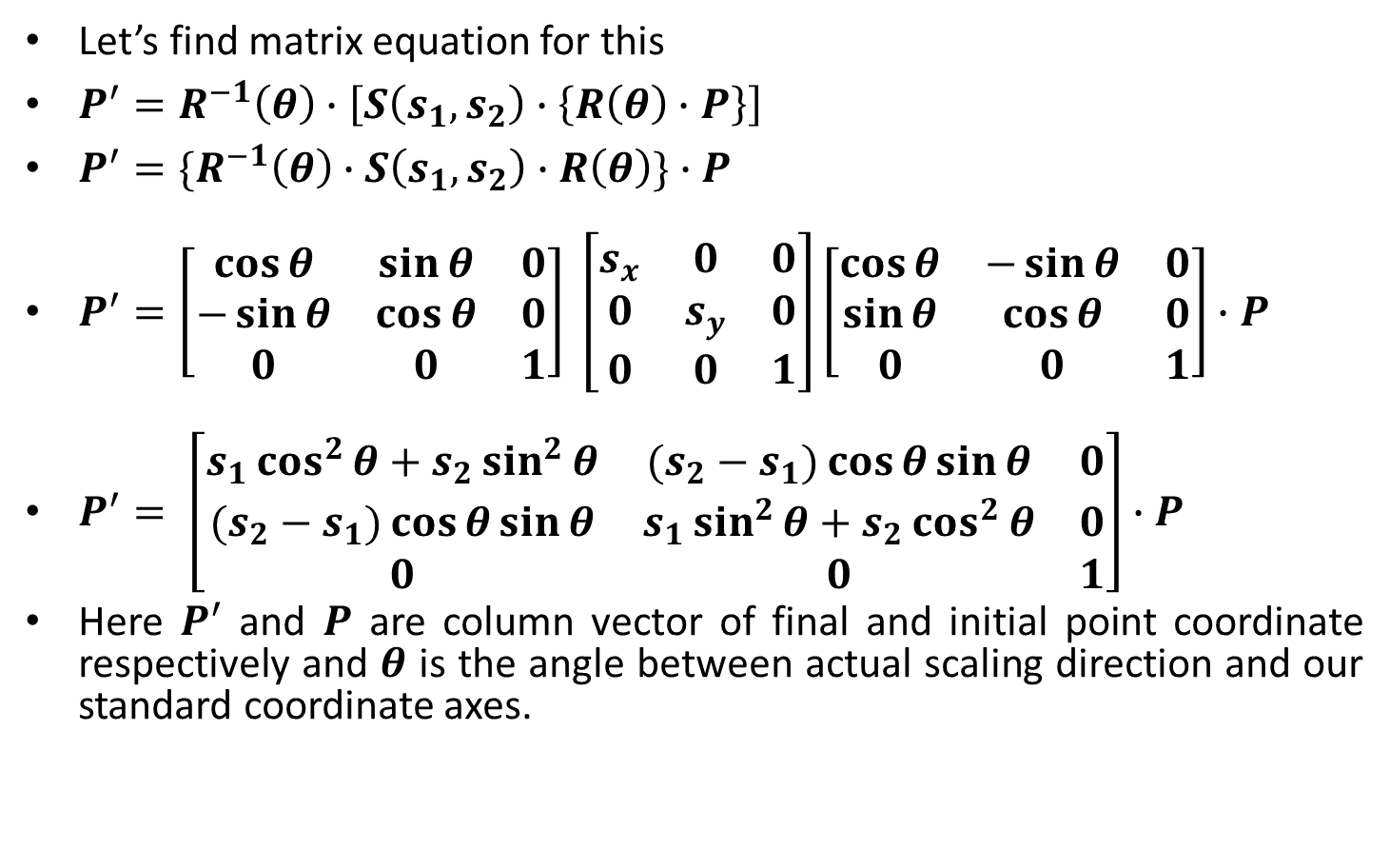
General Scaling Directions Equation

Slide 51
Other Transformation
Some package provides few additional transformations which are useful in certain applications.
Two such transformations are:
Reflection
Shear.

Slide 52
Reflection
A reflection is a transformation that produces a mirror image of an object.
The mirror image for a two –dimensional reflection is generated relative to an axis of reflection by rotating the object 180º about the reflection axis.
Reflection gives image based on position of axis of reflection. Transformation matrix for few positions are discussed here.

Slide 53
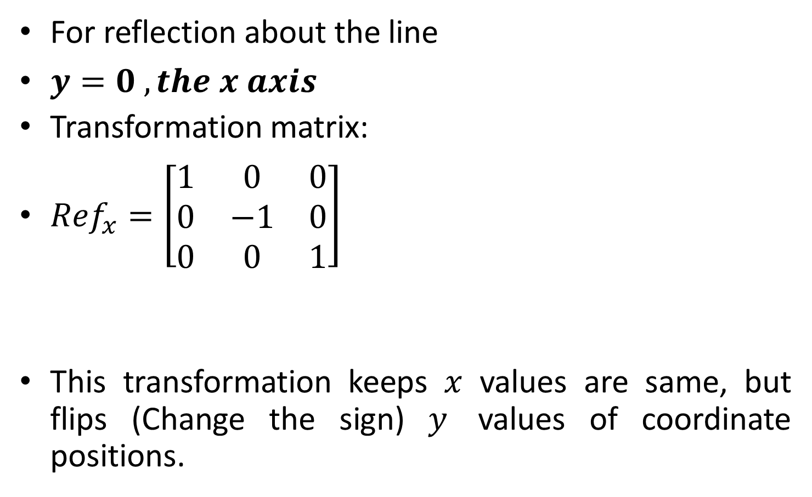
Reflection About X-Axis
y
1
Original Position
2
3
x
2’
3’
Reflected Position
1’

Slide 54
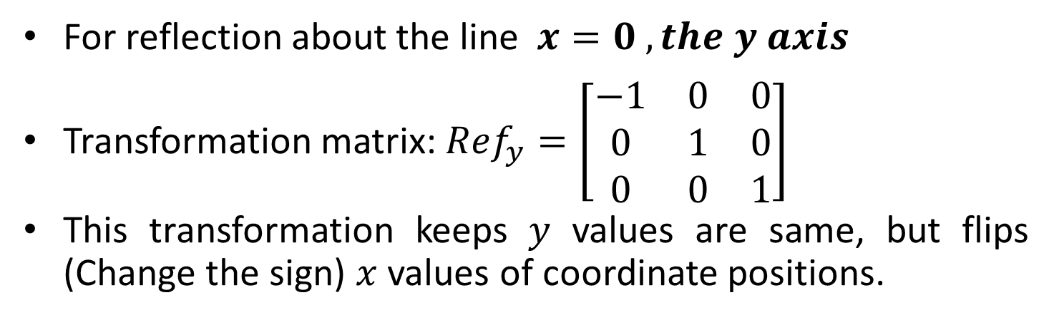


Reflection About Y-Axis
1’
1
Original Position
Reflected Position
3’
2’
2
3

Slide 55
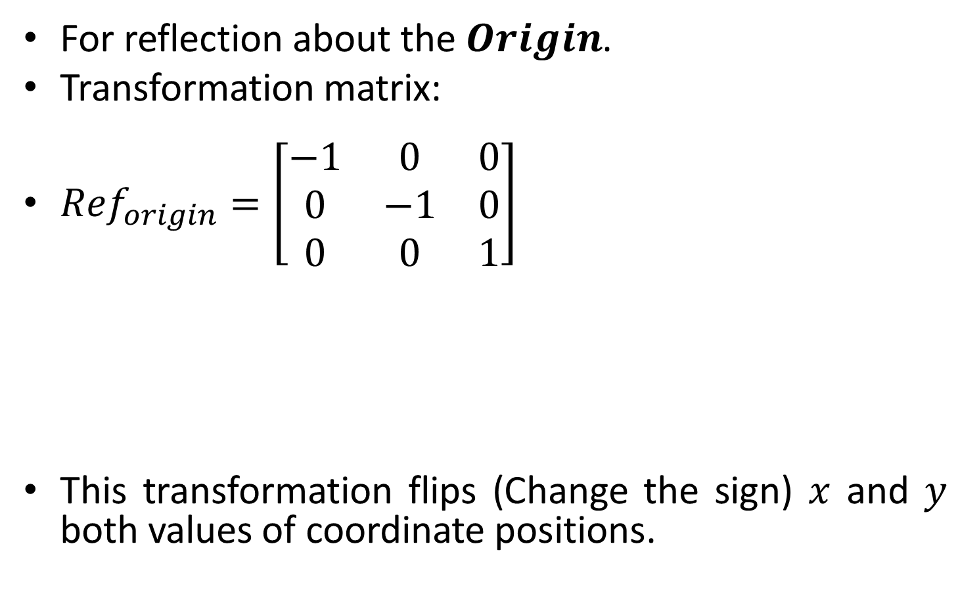


Reflection About Origin
Original Position
Reflected Position

Slide 56
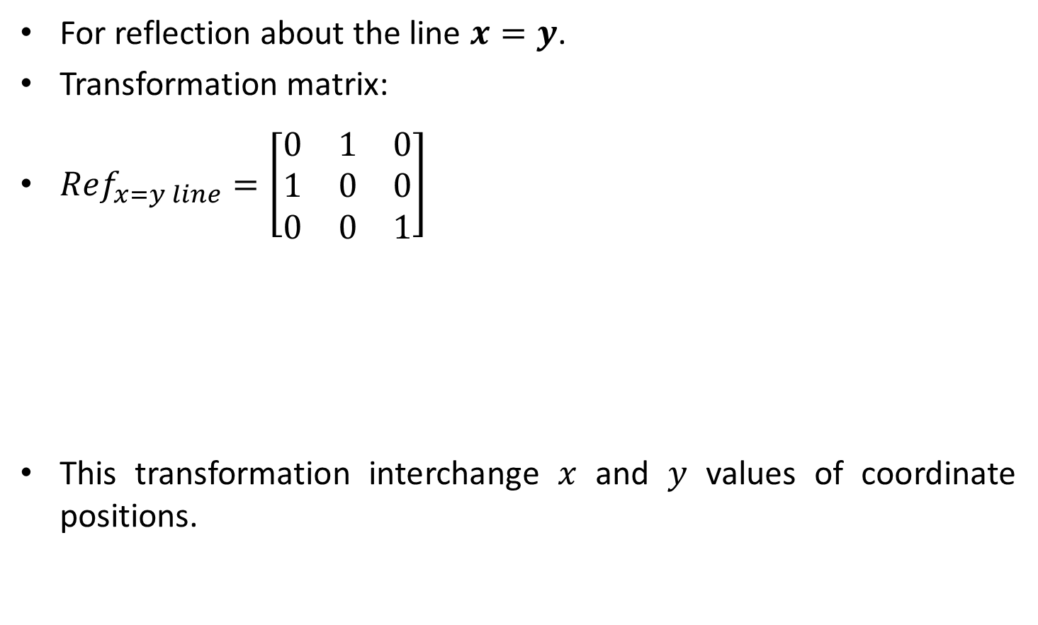


Reflection About X = Y Line
Reflected Position
Original Position

Slide 57
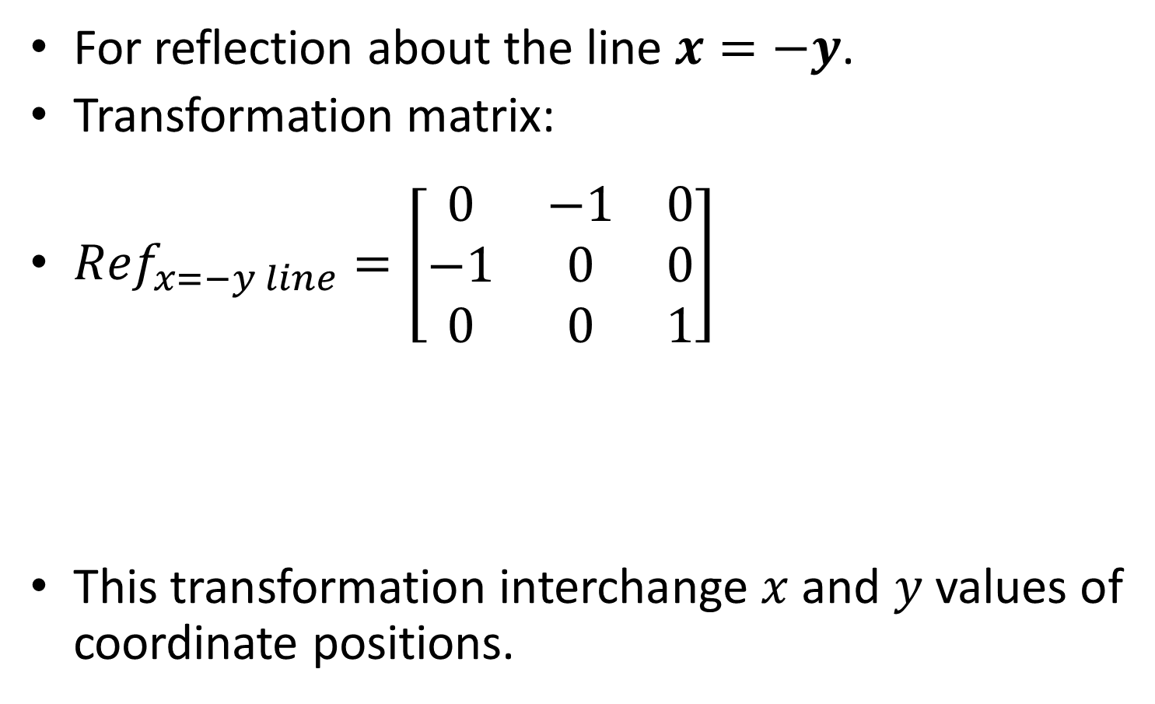


Reflection About X = - Y Line
Original Position
Reflected Position

Slide 58

Reflection Example

Slide 59


Slide 60

Shear

Slide 61






Before Shear
After Shear

Slide 62







Contd.
Before Shear
After Shear

Slide 63



Slide 64

Contd.

Slide 65






Before Shear
After Shear

Slide 66







Contd.
Before Shear
After Shear

Slide 67



Slide 68

Contd.

Slide 69
Window and Viewport
Window: Area selected in world-coordinate for display is called window. It defines what is to be viewed.
Viewport: Area on a display device in which window image is display (mapped) is called viewport. It defines where to display.
Window
Y_{Wmax}
Viewport
Y_{Vmax}
Y_{Wmin}
Y_{Vmin}
X_{Wmin}
X_{Wmax}
X_{Vmin}
X_{Vmax}

Slide 70
The Viewing Pipeline
In many case window and viewport are rectangle, also other shape may be used as window and viewport.
In general finding device coordinates of viewport from word coordinates of window is called as viewing transformation.
Sometimes we consider this viewing transformation as window-to-viewport transformation but in general it involves more steps.
Let’s see steps involved in viewing pipeline.

Slide 71
Contd.
Construct World-Coordinate Scene Using Modeling-Coordinate Transformations
Convert World-Coordinate to Viewing Coordinates
MC
WC
VC
Map Viewing Coordinate to Normalized Viewing Coordinates using Window-Viewport Specifications
Map Normalized Viewport to Device Coordinates
NVC
DC

Slide 72
Window-To-Viewport Coordinate Transformation
Mapping of window coordinate to viewport is called window to viewport transformation.
We do this using transformation that maintains relative position of window coordinate into viewport.
That means center coordinates in window must be remains at center position in viewport.
Window
Y_{Wmax}
Y_{W}
Viewport
Y_{Vmax}
Y_{V}
X_{W}
X_{V}
Y_{Wmin}
Y_{Vmin}
X_{Wmin}
X_{Wmax}
X_{Vmin}
X_{Vmax}

Slide 73

Contd.
Window
Y_{Wmax}
Y_{W}
Viewport
Y_{Vmax}
Y_{V}
X_{W}
X_{V}
Y_{Wmin}
Y_{Vmin}
X_{Wmin}
X_{Wmax}
X_{Vmin}
X_{Vmax}

Slide 74

Contd.

Slide 75

Contd.

Slide 76

Contd.

Slide 77
Contd.
For each display device we can use different window to viewport transformation. This mapping is known as workstation transformation.
Also we can use two different displays devices and we map different window-to-viewport on each one.
Normalized Space
W_{S1} Viewport
Viewport
W_{S2} Viewport
Monitor 1
Monitor 2
W_{S1} Window
W_{S2} Window

Slide 78
Thank You

